Slide 1
Training of Trainers
Career Development
Day 1 Intro
VNA project, My World of Work
Zanzibar

Slide 2
Karibuni
Programme
Welcome and introduction;
May I introduce myself?;
Expectations, objectives and approach;
Overview of the toolkit;
Your own career;
Self-assessment: your qualities as a professional in career guidance;
Practical assignment;
Needs assessment of the group of youth;
Reflection and looking forward.

Slide 3
May I introduce myself?
Take a seat on chairs put in an inner and outer circle;
In pairs tell each other who you are, your age, where you live, with whom, what you expect of this T-o-T Career Development and why you are motivated to attend the training;
Each of you has three minutes;
After six minutes the people in the outer circle move up one seat and then the new pair introduces her/himself in the same way. After this, move again one seat;
Finally, everybody introduces him/herself in the whole group by telling briefly name, motivation and expectations.
Notes:
This is an exercise (1.3.) of the toolkit: just tailor-made to this training. When it is not taking a lot of time, you can write down the expectations of all the participants, just in few words. When there are the same expectations, just give a stripe behind that expectation. Keep up the speed in the exercise.
At the end of all presentations you can ask for some feedback: what do you think about the exercise? Is this a good exercise to start with a new group? Why (not)? Suitable to your own youth?

Slide 4
Objectives
Raising awareness about the development of your own career;
Doing a self-assessment about your competences in guiding youth;
Setting goals what you want to achieve and making reflections in a logbook how to steer your own learning process;
Elaborate a practical assignment and how to work on it;
Making a start with the needs assessment of the group of youth you are going to guide.

Slide 5
Approach
How do we work?
Learning from each other;
Learning with each other;
Active contribution of all of you;
Shared responsibility for the result;
Learning by reflection;
Learning by doing;
Practicing the exercises.
Notes:
When your first training day starts too late (on our first day we started five to six quarters (!) too late, because a lot of people were not there in time), then it is good, to add another excercise here before you show this approach. The exercise is also in the toolkit ‘Golden rules’ (1.6.). Together you will make a list of golden rules that people want to follow up during the training. Punctuallity will be part of it, ask them what to do when peope are not behaving like this.

Slide 6
Introduction Toolkit My World of Work
Vijana na Ajira, Youth and Employment, VNA- project Zanzibar 2014 – 2018:
Job fairs and entrepreneurial fair 2015 and 2016;
CBET approach in Vocational Training Centers and Technical Institutions;
International Citizen Service (ICS) Tanzanian and UK volunteers train youth of Zanzibar;
Career Development as an important part in CBET approach, see CBET tree.
Notes:
For more information about the CBET approach, you can have a look at the Introduction training on CBET. It is in the toolkt of the MY World of Work component of the VNA project. In the next slide you can see a summary of the CBET approach.

Slide 7
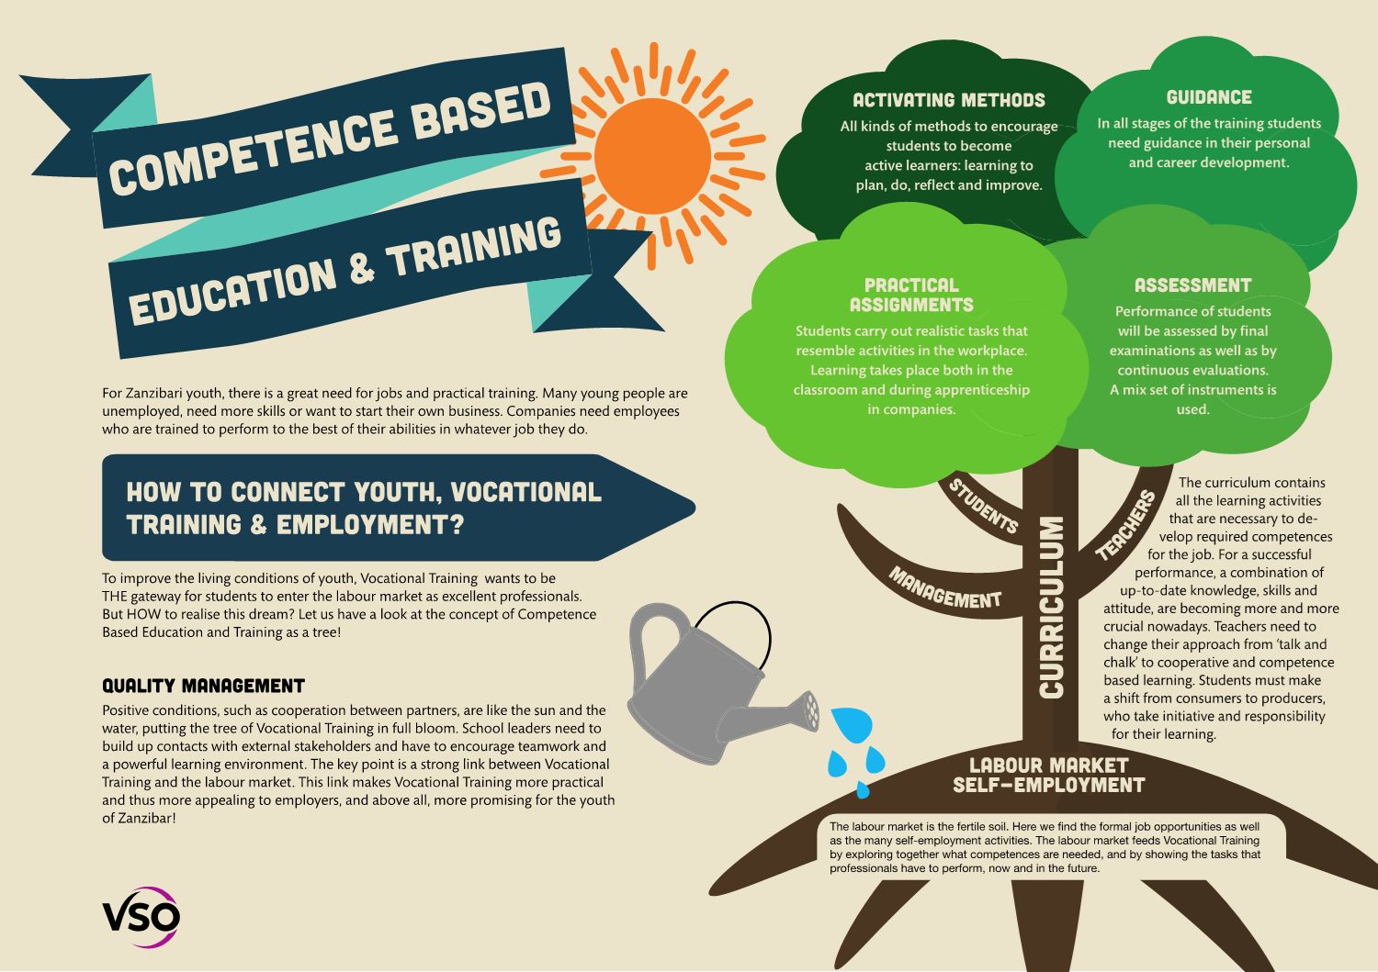
Notes:
Highlight the most important characteristics of CBET. Explain the metaphor of the tree: roots, stem, branches, leaves, the sun and the water. Using this metaphor helps to make the shift less
abstract.
In the metaphor of the tree you can see how Career Development is linked to CBET. CD is a part of CBET and deals with Guidance in personal and career development. Giving guidance is a way to connect youth to the labour-market and to self-employment opportunities. So make sure that you always connect youth to real practice (fieldtrips, visits to companies, inviting people from companies in the class, internet search: a lot of opportunities to connect education, youth and the labourmarket!

Slide 8
Toolkit Career Development
How to guide youth to vocational training and (self-) employment?
The exercises are arranged in 6 career competences;
More than 130 exercises;
Goals:
  to enable the design of tailor-made programmes;
  to meet the needs and levels of students and jobseekers;
Add your own exercises….. This programme, toolkit will grow.
Notes:
Ask whether somebody can tell what is meant by ‘tailor-made programmes’ and why that is so important.

Slide 9
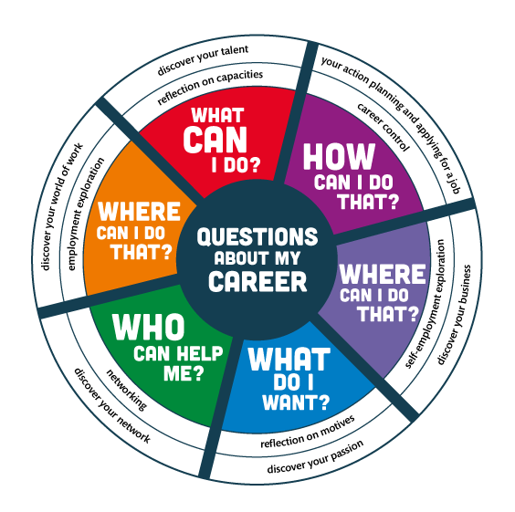
Notes:
These questions in the compass will come back during the next six days when a topic is elaborated. It is good to start from the beginning to ask your participants what they think the topics are about, and adjust their first trying's in a positive way.

Slide 10
Topic 1: Discover your talent
What do you mean by ‘Discover your Talent’?
Why is this topic important when you guide youth in their career?
Notes:
means: thinking about your qualities and how you can use these qualities to develop your career. Students/jobseekers and job creators reflect on the qualities they use in everyday life, at school and at (informal) work. They ask others (graduates, teachers, fellow students, employees, entrepreneurs and family members) to give feedback on what they are good at and on what to improve.

Slide 11
Topic 2: Discover your passion
What is this topic all about?
Why is ‘Discover your Passion’ important for the youth?
Notes:
means: thinking about your aspirations and values that are important for your career. Students/job seekers and job creators are becoming aware of what they think is important in their life, their education and career. They will discover what gives them a feeling of satisfaction, what they like or dislike and what they (still) need to develop with regard to their ambitions.

Slide 12
Topic 3: discover your world of work
What do we mean when we talk about ‘Discover your World of Work’?
Why is ‘Discover your World of Work’ important for the youth?
Notes:
means: exploring current and future requirements and values in the profession you aspire. Students/jobseekers and job creators develop the skill to find work/a job that corresponds to their personal values. They learn how to find a balance between the prevailing standards/values of the work place and their talents/personal values. Employment exploration is about getting a taste of the reality of the world of work.

Slide 13
Topic 4: discover your network
What is a network?
Why is ‘Discover your Network’ important for the youth?
Notes:
means: identifying your network, building and maintaining it, so that you can develop your career in the best way possible. Students/jobseekers and job creators develop the skill to use their network in such a way that they first can obtain a place in the job market and later on can maintain or change it. They learn how to communicate about what they want and need for their career.

Slide 14
Topic 5: discover your business
What do we mean by ‘Discover your Business’?
Why is this topic important in Zanzibar?
Notes:
means: exploring whether you would like to start your own business and develop your career as an entrepreneur/business(wo)man. Students/jobseekers and job creators learn the meaning of how to behave in an entrepreneurial way, how to develop a clear vision about the enterprise they want to start and how to build up skills to make that vision concrete. They learn to set entrepreneurship in motion.

Slide 15
Topic 6: Your action planning and applying for a job
What is meant by ‘Your Action planning and Applying for a job’?
Why is this important for the youth?
Notes:
means: planning, controlling and adapting your way of learning and working, with the intention to streamline your career development. Students/jobseekers and job creators develop the skill to take initiative and responsibility. They acquire the skill to obtain, keep or change their position in the job market. They learn how to find a job, how to create a CV, and how to conduct an interview.

Slide 16
Structure of Toolkit CAREER DEVELOPMENT
Overview of all exercises per topic
Description of each exercise:
Goal;
Preparation;
Explanation;
Performance;
Reflection;
Tips;
Further examination;
Worksheets.

Slide 17
As an interviewer….
Think about:
Asking open questions
Attitude without giving judgments
Careful listening
Summarising clearly
Notes:
Before you explain the next exercise about the interview you just take some time to think about these skills needed to do a proper interview, ask them why these skills are so important.

Slide 18
Your own Career
Find a colleague you want to have an interview with about each other’s career;
A is interviewer, B tells about his/her career (10 minutes). After the interview you change roles;
Take 10 minutes to summarise the most important things in the career development of your partner;
In the whole group A gives the summary of B and B gives the summary of A about the most important issues in the development of each other’s careers.
Notes:
Manage your time in a good way, follow the energy in the group, don’t be rigid, but keep a good idea of what and how they are doing this interview. When they summarise in the whole group, sometimes you can connect their stories with the different career competences you have elaborated with them during the slides in the morning. Keep up moving, otherwise the summaries will take too much time.
Reflect with the group what they learned from this exercise.

Slide 19
My qualities in career guidance
STARR is a reliable interview technique used to reflect on competences;
The STARR interview is very suitable for exploring experiences;
The interview is also known as competence based interview, criterion referenced interview or behavioural event interview.
Notes:
Now another way of interviewing somebody with clear steps, not that open as the former interview.
In recruiting people this way of interviewing is used often as it gives a good idea of somebodies competences.

Slide 20
STARR
Situation
Task
Action
Result
Reflection
Notes:
To each topic in this interview you can ask again open ‘what and how’ questions. See to the questions below and in the worksheet 1.3.

Slide 21
Situation
Can you give an example of a concrete situation which illustrates (some of) your competences?
Tell me more about it.

Slide 22
Task
What exactly was your task in the situation? What did you have to do?
Can you explain more about your task?

Slide 23
Action
What exactly did you do?
What actions did you take?
What was your approach?
Why did you do it this way?

Slide 24
Result
What was the result of your action?
What did you think of the result?
What did the others think of the result? (your boss, your colleagues, your students)

Slide 25
Reflection
Did it go according to your plan?
What would you do differently next time and why?

Slide 26
Preparing STARR interview
Choose one of your competences in career guidance;
How can you proof that you have this competence?
Prepare the interview in which the counselor/assessor will use the STARR method.
Notes:
In our training we had less time, because we started so late. That is why we got the idea to present a STARR interview by ourself. Sophie interviewed me about my qualities in Career Development. It gave a good idea how it works and it helped them in preparing their own exercises and then it took less time. You, as a trainer can do this STARR interview with one of your participants or if you have a co-facilitator, do this STARR interview with your co-facilitator.

Slide 27
Carrying out the STARR interview
Form a sub-group of 3 persons:
  Interviewee
  Counselor/assessor
  Observer
Carry out 3 interviews in 3 steps:
  Preparation
  Interview
  Feedback
Change roles (3x)
Notes:
Handed over the worksheet, (1.3.) that can be used to the counselor to get more ideas of the questions he/she can posed and to write down the answers of the interviewee. Make sure that they do follow the steps, but not rigid to all the questions on the sheet, the questions are depending on the answers of the interviewee and whether it is clear what he/she tells.
The worksheet (1.4.) will be used by observer to write down his/her observations.
For the feedback step: first the interviewer tells what he/she experienced, then the interviewee tells what he likes from the interview and what he learned from it. Then at the end the observer gives his/her observation about the way the counselor has done it. Did the interviewer took the right steps in a good sequence? Was the step clear? Did he/she posed open questions? How were the summaries? What was good, what to improve? By doing this feedback round three times, participants will learn more about this STARR technique. This technique in a slight different way, is also used in the toolkit Career development in topic 3, exercise 24

Slide 28
Logbook
Reflect in your logbook on the following questions:
What did you learn about your own career?
What are your qualities in guiding youth in their career?
What competence(s) do you want to develop (more) to become a professional in Career Guidance?
Notes:
Get used to let participants reflect in their logbook. Take your time for it. Too often I took less time for it and asked them to do it as homework. And then they didnot do it (you can imagine it yourself). But when I did it in a proper way and asked them for silence to do it, participants always were very secure, thoughtful and learning to reflect in positive critical way to themselves.

Slide 29
Practical assignment for this training
Read the hand-out 1.6. with the practical assignment;
Discuss within your subgroup what it is all about;
In the whole group we give answers to the questions raised;
Choose a colleague to design together a programme on Career Development for students, employees or jobseekers during this T-0-T and afterwards to deliver your tailor-made programme in your own projects.
Notes:
It take much time to read the practical assignment. Most participants are not used to such assignments and especially when English is not very good, it takes more time. So now it is very nice that everything has been translated in Kiswahili. Also it will take time to understand the practical assignment, encourage them to cooperate. When there are two colleagues of the same organisation, they can form a pair, a couple that makes one tailor-made programme for their youth. Sometimes there are also individuals with a different target group. Those individuals will make their own tailor-made programme, but still the individuals can work together for sparring, sharing their results and supporting each other.

Slide 30
Planning practical assignment
Each pair or individual starts making a plan how to complete this practical assignment;
Start with a needs assessment of the group of youth you want to deliver this programme to.
Notes:
At the end of this activity everone, every couple will be at a different stage of their work. Just finish this by asking whether there are questions or tips? The practical assignment will come back each trainingday!

Slide 31
Reflection
What do you like about this day?
What wishes do you have?
Notes:
Write down for yourself what they liked from this day. It will help you to continue the way you deliver the training. The same for the wishes, make sure whether you can fulfill these wishes or not. If not, tell them and give the reason why not.

Slide 32
looking forward
Hand-out for everyone the USB-stick with the whole Programme on Career Development;
Homework for the coming week:
  Improve your plan for the practical assignment;
  Make the needs assessment of the youth for whom you design the tailor-made programme. Share this in your institution and update it after getting feedback;
  Have a first look at Topic 1 ‘Discover your Talent’;
Next week we‘ll discuss the homework and the topic ‘Discover your Talent’;
Take your laptop with you! So we can share the exercises.
Notes:
When you have a proper list of participants with all the email-adresses, you can send them an email between the first two training days. I always did that to reflect on the first day, how nice it was and some of the big expectations I had from them.
Then I remembered them to the housework they need to make and that we are going to discuss it next training day. I included also the programme of the next day already.

Slide 33
Training of Trainers
Career Development
Day 1 Intro
VNA project, My World of Work
Zanzibar

