Slide 1
The concept of CBET
Introduction Training on CBET
Day 1
VNA project, My World of Work
Zanzibar

Slide 2
Welcome and introduction
Brief introduction on Vijana Na Ajira project;
Who is who and expectations;
Objectives Introduction Training on CBET;
Approach;
The concept of CBET and the paradigm shift;
CBL in daily practice and the CBET tree;
Scan of your institution;
Your practical assignment ‘design and deliver an introduction training on CBET’ for a group of teachers of vocational training.
Notes:
The programme of this first day is very tight. In the reality of Zanzibar we were not able to do a real Training of Trainers with this practical assignment. We had not enough time and our planning was disturbed more than once. But we did a practical assignment in the training on the toolkit Career Development (to make a tailor-made programme for their own youth) and that was a very good way of applying the training and making sustainability possible. So I think this will be also a good one for more applying, sharing and implementing the CBET approach in Vocational Training. That is why you can find this practical assignment in the programme of this first day. So if you are not going to use this practical assignment, you can take the whole day for this topic ‘The concept of CBET’. This is about the delivered introduction training CBET on Zanzibar,

Slide 3
Who is who and expectations
    Write your name, institution and area of specialization on a card;
    Write down in a few words what you expect to learn in this Introduction Training on CBET?
    Introduce yourself and your expectations briefly in the group.
Notes:
Time keeping is important. A tip: you as a trainer start introducing yourself. You set the example. You show how to do this, using a few words.

Slide 4
Objectives
Understanding of the concept of CBET;
Awareness of the paradigm shift towards CBET illustrated in 5 topics;
Identification of the implications of the shift: scan your institution and make the major challenges visible;
Explanation of the practical assignment that each of you is going to make during this training: what, how, planning?
Notes:
When you don’t use the practical assignment you can delete this objective.

Slide 5
Working hours
09.00 – 10.45 : Welcome and Concept of CBET
10.45 – 11.00 : Break
11.00 – 12.50 : Scan of your institution and major challenges
12.50 – 14.00 : Prayers and lunch
14.30 – 15.45 : Practical assignment
15.45 – 16.00 : Reflection and looking forward

Slide 6
Approach
How do we work?
Learning from each other;
Learning in cooperation;
Active contribution of all of you;
Shared responsibility for the result;
Learning by reflection;
Learning by doing.
Golden rules
Discuss with your neighbour what you like about this approach and what golden rules you yourself want to set.
Notes:
It is important to explain the principle: ‘teach as you preach’. Because CBET is about student centred learning, you cannot give a training in a teacher centred way. This implies that the participants in this training are active and that the trainer focusses on the process of learning. It will be clear that both parties (trainer and trainees) have to try-out these new roles. Always important to ask which golden rules they want to set. Put them on a flipchart as a reminder during all the training.

Slide 7
The concept of CBET
CBET: Competence Based Education and Training
Why, what and how?
Notes:
Depending on the knowledge the group has, you can explain that in literature other terms are used to point at a new approach of learning. In most cases it is about the shift from a teacher centred approach (teachers talks to the group and writes on the blackboard) to a student centred approach (students discuss, share and work also in small groups and individually.

Slide 8
FAQ and answers: the shift towards CBET
Write down a question you would like to ask your colleague about this topic;
Walk around, meet a colleague, put your question and listen to his or her answer;
Next, your colleague asks you a question and you give an answer;
You have 3 minutes for the two of you, then you move on to another colleague.
Plenary: What was new or interesting for you?
Notes:
This is a kind of ‘free’ thinking about the concept of CBET. It is good to say that there are no stupid questions. In the plenary session, it becomes clear which thoughts or misunderstandings need more explanation or discussion during the training.

Slide 9
What is CBET?
CBET = Competence Based Education and Training
CBET is a learning and teaching approach that enables learners to:
  Acquire competences that are needed and relevant for their future profession;
  Perform in their job according to professional and occupational standards.
CBL = Competence Based Learning
Notes:
Emphasis is on learning those competences that are required by the labour market to perform well as an employee, but also when you are self-employed.

Slide 10
What is a competence?
Integration of
knowledge, skills and attitude
Knowledge
Skills
Attitude
Competences

Slide 11
Why Competence Based Education and Training?
Competence Based Education and Training
New views on learning and teaching
Changes in the profession/labour market
Notes:
The urgency to make a shift comes from two sides: the labour market has new requirements and research shows that some methods of teaching are more effective.

Slide 12
Shift happens
Let us have a look what is going on:
https://www.youtube.com/watch?v=FdTOFkhaplo
https://www.youtube.com/watch?v=wMB77eJPYs8
https://www.youtube.com/watch?v=uqZiIO0YI7Y
Notes:
There are three versions, the original one and then for the next years. Prepare yourself and select which one you want to show. Check whether you have good access to the internet. The other ones can be seen at home.

Slide 13
What does a competent graduate or employee look like?
Make in pairs a list of characteristics of a competent graduate or employee…;
Compare the outcomes in your group;
Compile the main characteristics into one list!
Compare your list with the next slides.
Notes:
Let participants brainstorm. All ideas are welcome.

Slide 14
The ‘competent' professional….
  Takes initiative;
  Can improvise and comes to innovative solutions;
  Takes responsibilities;
  Is aware of the necessity to improve the quality of his/her work;
  Is prepared to develop himself and keep his/her knowledge and skills up-to-date.
Notes:
Most important characteristic is that a professional is dynamic. Flexibility and active participation are required in our changing society.

Slide 15
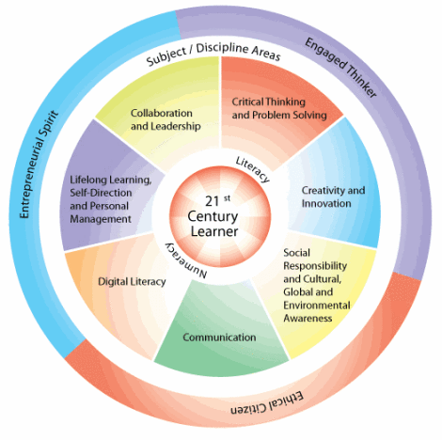
Competences of The 21st century learner
Notes:
Participants can also check their own list with this one.

Slide 16
A competent person
Knows and understands why
  = Cognitive competences
Can act/do
  = Strategic competences
Can react/interact
  = Social emotional competences
Notes:
Discuss that a professional always keeps on learning and that a successful employee has to develop various qualities: skills to think, skills to do, skills to maintain relations.

Slide 17
How to acquire competences?
Competences cannot be transmitted by an expert;
Competences have to be developed by the learner him/herself!
The expert facilitates the learner to learn (= how to become competent).
Notes:
The shift to CBET implies a new role for the teacher and for the student. We do not develop competences from a book nor by being told what to do. Competences we learn from doing and from critically thinking about what we do and why.

Slide 18
New views on learning are necessary
Lack of effectiveness of knowledge-based technical training; too much emphasis on ‘transmission’.
Development of new theories on learning:
Learner centred/learning how to learn;
Shared control;
Flexibility/tailor-made;
What you have learned, you must be able to show;
Learning by reflection on action;
Cooperative learning.
Notes:
It is important to talk about the different terms that are used and the different views on learning. There is not one single approach that covers all requirements. There is no method that gives 100 % guarantee to learn all competences.

Slide 19
Competence-Based Learning is an....
Active;
Constructive;
Integrated;
Work-related;
process of development and improvement by the learner, that has to be facilitated by the teacher.
Notes:
Focus is on the statement that the learner has to learn himself/herself. The teacher cannot take over the learning from the student. The teacher is responsible to create conditions and to support the learner when he/she meets difficulties.

Slide 20
Conclusions?
Make a slogan in your subgroup;
Write down in a few words what ‘CBET: why, what and how’ stands for;
Put them on a flipchart and put it on the wall.
Notes:
You can make this exercise more lively by asking participants to make a slogan for a T-shirt. On the front side they write a slogan about the CBET student and on the backside a slogan about the CBET teacher. You can also put the slogan of a subgroup on a flipchart, later on the day, when they have learned more about CBET, you can ask them to update the slogan. The presentation of the slogan can be done on the next day. Then you have already a good reflection on the first day.

Slide 21
Shift from KBL to CBL
What are the features of CBL?
In the left column of the table (hand-out 1.4) are listed some features used in the direct or instructional mode of teaching (KBL);
Write down individually the features of CBL in the right column: What does the shift imply?;
Share your answers in the subgroup and make one list.

Slide 22
Shift from KBL to CBL (cont.)
Compare - in your subgroup - your answers with the table that you can find in the hand-out 1.5;
Are there similarities between this list and your list? Are there differences?;
Make adjustments -if needed- in your own table;
In a plenary session we check if we have understood well what the shift implies.
Notes:
It is important to discuss in the plenary session what the shift exactly implies. For participants it might be difficult to visualize what the new way of teaching and learning looks like in practice, as most of them have no experience with CBET. Do not give theoretical definitions, but try to come up with examples and suggestions.

Slide 23
Principles of CBET
From what we have discussed thus far about the shift from KBL to CBL, what do you think the basic principles of CBL are?
Write down in your logbook your answers on the first two questions.
Notes:
This exercise represents a moment of repetition, a way to have the information well stored in your mind. By consciously summarising what you have learned, learners actively memorize the most important pieces of information. Those pieces they can re-call later.

Slide 24
CBL in daily practice
The shift towards CBL, Competence Based Learning
Current situation in
Institutions of Vocational Training
Notes:
In order to be able to make the shift to CBET, a teacher must know what is his starting point. If he/she knows what the current situation looks like, he/she also knows which gap he/she has to bridge to achieve the ideal situation. In the next slides the application of CBET principles in daily practice is demonstrated. Finally participants make a scan of their own institution: what does the teaching actually looks like and where to go?

Slide 25
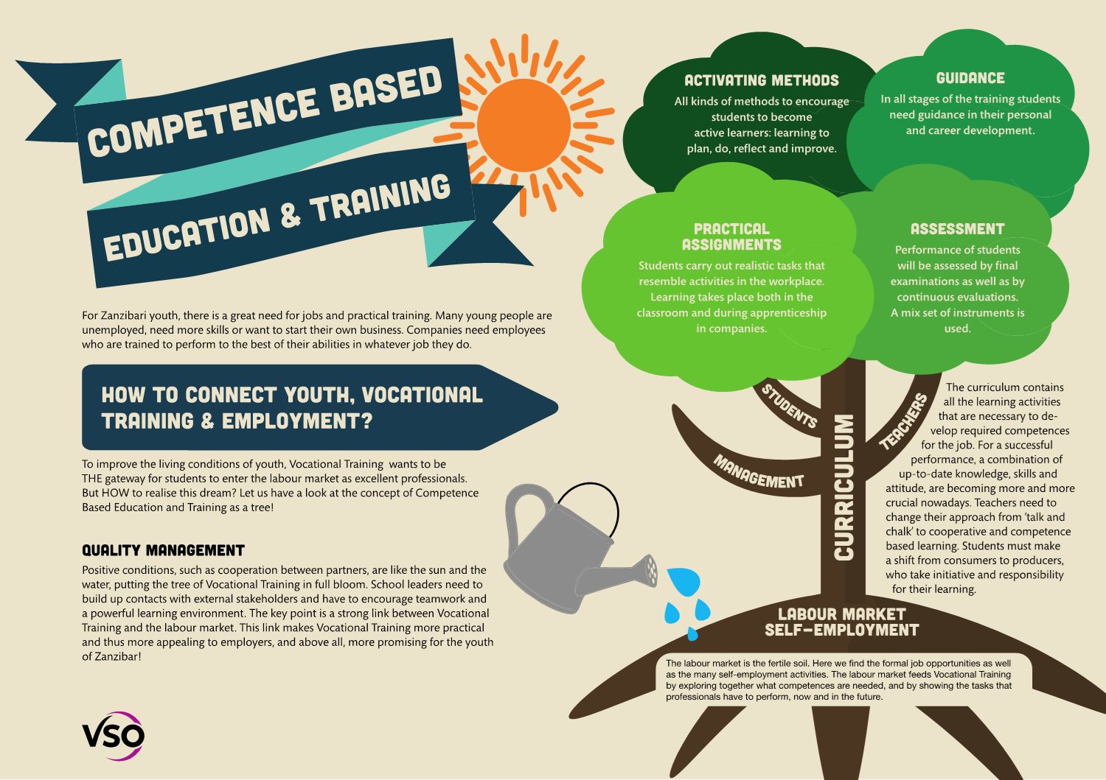
Notes:
Highlight the most important characteristics of CBET. Explain the metaphor of the tree: roots, stem, branches, leaves, the sun and the water. Using this metaphor helps to make the shift less abstract.

Slide 26
The CBET tree
Discuss with your neighbour the different elements that together shape CBET;
In which elements are you involved?;
Can you identify other persons -besides teachers- who have a task to make the CBET tree grow?;
Do you ‘work together’? Explain how?
Notes:
The trainer can ask participants to think about who is involved, looking at the roots, the branches, the sun etc..

Slide 27
Topics illustrating the change towards CBL
Concept and general principles;
Design of learning activities;
Facilitation: teaching and learning strategies;
Guidance;
Assessment.
What is the main shift in each of these five topics?
Notes:
To help participants to answer this question, the trainer can refer again to the CBET tree. The general principles have been discussed in the first exercise in the morning

Slide 28
Scan your institution
Read carefully the statements in the paper ‘From Knowledge-Based Learning (KBL) to Competence-Based Learning (CBL)’, hand-out 1.6;
Make sure that you understand the shift from KBL to CBL regarding the topics A, B, C, D and E. Discuss the shifts with your neighbour;
After that, score individually your current situation in your own vocational training institution (see the scoring instructions on the hand-out 1.7).
Notes:
Give participants time to understand the shift. If there any questions, the trainer can give some more explanation.
The timetable on this first day is very tight. You really need the whole day on this topic ‘The concept of CBET’.
After this exercise you can ask them to update as a subgroup their slogan!
Also logbook writing can be done after this one…
I just put this practical assignment (develop and deliver your own introduction training within your institute) in this Introduction Training on CBET to give an idea how to implement CBET more and more. So schedule extra days when you want to facilitate a proper Training of Trainers.

Slide 29
Priorities of change: individual
What do you want to apply in your own lessons about CBET? Look at your scoring at the scan. Choose individually three subjects you want to apply in a more CBET way;
Share those points within your subgroup and come up with ideas how you will practice those points;
Make a concrete plan in your logbook what and how you will apply: this weeks, during training and afterwards.
Notes:
You can choose just to prioritize on the individual level ( as in this slide) or on the organisational level (next slide). Maybe you can do both of them.

Slide 30
Priorities of change: as a group
Read hand-out 1.8 Priorities in the shift towards CBET;
Follow the steps to prioritize the subjects you prefer to develop in your institution. Give them your 7 points;
On the wall you can put your stickers/your points, together with the colleagues of the same institution;
Share those points with your colleagues and come up with ideas how you will develop those subjects in the policy of your institution;
Make a concrete action plan in your logbook what and how you will work on the development and implementation of CBET in your institution. Put your work as a group on a flipchart as well.
Notes:
In hand-out 1.9 all the subjects of the hand-out 1.8 are in big letters, to be used for the stickering of groups. Make sure that you have put the papers already on the wall. You can give each group of the same institution their own overview, or you can give them their own colour of stickers. It is necessary that they can discuss about the their goals and actionplanning on implemenntation of CBET. Every group can have other priorities, so it is important to share within their own institute/field of practice.

Slide 31
Presenting action plan
Present your individual or organisational plan briefly;
Together we will give feedback whether the goals and the action planning are:
  Specific
  Measurable
  Attainable
  Relevant
  Time bound
Update your goal and plan, so you can work on it.

Slide 32
practical assignment for trainers
Read the practical assignment 1.10 you are going to carry out in your own institution;
Find a colleague with whom you want to develop and deliver an introduction training on CBET in your own institution;
Make together a plan how you will carry out this practical assignment;
You can use the various hand-outs and PowerPoint presentations, available in this manual.
Notes:
See for more preparation in the separate map in the manual day 1.

Slide 33
Presentation of plans practical assignment
Discuss your plan with other participants;
Give each other feedback;
Adjust your own plan when you get some good ideas from others;
Notes:
Let participants give each other feedback. Make sure that they also plan a meeting with their management, HRM people about this practical assignment. It is necessary that they get commitment from them and can get some suggestions how to arrange this. To whom can they deliver this introduction training? How to combine this with other activities on capacity building? It is also important that they are also talking with their colleagues at school to learn what they want to learn/share.

Slide 34
Reflection and looking forward
Give a compliment about this day and formulate a wish for next day.
ASANTE SANA

Slide 35
The concept of CBET
Introduction Training on CBET
Day 1
VNA project, My World of Work
Zanzibar

