Slide 1
CBET and activating methods
Introduction training on CBET
Day 2
VNA project, My World of Work
Zanzibar

Slide 2
Welcome and introduction
Programme
Reflection on day 1;
Expectations and objectives of day 2;
The shift in teaching and learning;
Activating methods;
Practicing activating methods;
Reflection, conclusions and homework;
Evaluation.

Slide 3
Objectives
Awareness of the shift that should be made from KBL (Knowledge Based Learning) to CBL (Competence Based Learning);
Reflection on the methods we use in our courses and introduction of activating methods;
Practicing activating methods;
Logbook writing today and in coming weeks.

Slide 4
How do we teach?
Think about your courses:
Which methods are you using?
Give your first thoughts. Everything that comes up in your mind is o.k.
Let us look at the list we made:
Which methods are most frequently used?
Discussion: do we teach in a KBL or in a CBL way?
Notes:
As described on this slide, the brainstorm takes place in a plenary session. The trainer writes down the ideas on a flipchart. It is also possible to do the brainstorm in subgroups. Then you ask the participants to write down their ideas on a flipchart. When the brainstorm has stopped, participants hang their flipcharts on the wall, everybody walks around to see what is written on it and they talk about it. Then you have the same discussion as in the plenary session.

Slide 5
The shift in teaching and learning
In the left column of the table (hand-out 2.4) are listed some features used in the direct instructional mode of teaching (KBL);
Write the features of CBL in the right column:
Share your answers with your neighbour;
Compare your answers with hand-out 2.5. or with the next slide;
Make corrections or add characteristics;
In a plenary session we discuss the shift.
Notes:
It is good to give students enough time to think about the shift. Let them discuss the different ways of teaching on slide 6 and 7. In a plenary session you can give more explanation about the new approach and you can give feedback on their suggestions what CBL implies.

Slide 6
Two ways of teaching
Direct instruction/transfer of knowledge by teacher | Building/construction of knowledge by learners
Focus on academic content: what? | Focus on learning: how?
Teacher-centered | Learner-centered
Teacher explains, demonstrates, asks questions, checks the answers | Teacher interacts, responds to questions from learners, gives challenging assignments
Learners listen, observe, repeat and give answers | Learners explore the topic, experiment, reflect, cooperate
Notes:
The left column is about the KBL approach and the right column is about CBL. Ask questions and check if participants understand well the differences.
In KBL the focus is on the content that teachers transfer to learners who are lacking knowledge. CBL on the other hand is building on the (little knowledge) and experience the learners have. New knowledge should always be linked to existing knowledge, ideas and assumptions.

Slide 7
Modes of teaching
Modes/Methods | Instructional format
Instruction/ plenary session | Conventional lectures and lessons, film and video presentation, demonstration.
Individualized learning | Individual study of texts, study of open learning materials, self-instruction, assignments, projects.
Group learning | Buzz sessions, class discussions, seminars, group tutorials, games and simulations, group projects.
Notes:
Note: the best ‘recipe’ for effective learning is a mix of the three modes: plenary instruction/individual work at tasks/group work. Also teacher centred learning can be effective when it alternates with group discussions or practical assignments etc.

Slide 8
Cooperative learning
It is a two way teaching and learning process. Teacher and learner interact. Also the learner asks questions and gives explanation. Learners teach each other.
Knowledge is constructed and transformed through collaboration and social interaction.
It encourages learners to think critically, to develop an inquiry mind, to be independent and to have confidence.
Notes:
Cooperative learning is more than a group discussion. It is a specific instructional model that stimulates learners to take the role of the teacher. Underlying principle is that you learn most from what you tell others. Look at the learning pyramid on the next slide.

Slide 9
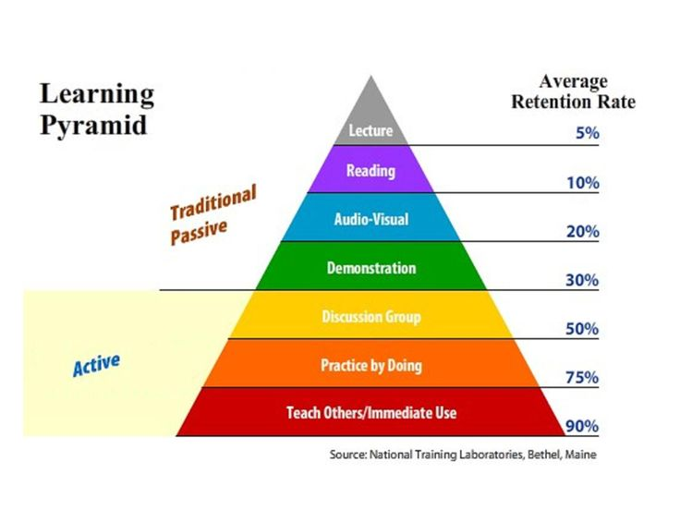

Learning pyramid
Notes:
The learning pyramid shows that learners learn more when they are active: they discuss, they practice, they teach others.

Slide 10
Rules for cooperative learning
Teaching is not telling and learning is not listening;
The less the teacher talks, the more the learner learns;
The more the learner talks, the more he/she learns;
Equal chance for talking, thinking and learning in a group;
Be accountable for your team;
Accept criticism and diversity.
Notes:
Both teachers and students have to learn. The teacher must learn to listen to the answers and provoke questions. The student must learn to ask questions and give comment. Learning in a group means that you are responsible for the group result. If some one in the group stays behind, every other member of the group is responsible to get him back to the front row.

Slide 11
New strategies
The focus on CBL implies a new teaching style and new learning strategies;
There is a need to shift from direct instruction (lectures, classroom teaching and teacher’s control) to cooperative methods (work related projects, group work, peer assessment and a combination of individual tasks with discussion and presentations);
The focus is on active participation and learning from each other.
Notes:
It is good to keep in mind that in literature various terms are used that refer to the use of the new teaching methods: CBL, cooperative learning, active learning, participatory learning, student centred learning, outcome based learning, problem based learning, discovery learning, deep learning etc. There are differences between these strategies, but what is in common is more important. They all want to emphasize that content is important, but that even more crucial the question is how we learn to adopt the content in such a way that we can apply what we have learned in practice.

Slide 12
Reflection on your teaching methods
Write down in your logbook three methods that you always use when teaching;
Do they belong to the activating methods? Explain why ‘yes’ or why ‘no’;
Write down your first ideas in what way you could improve your usual approach?
Notes:
Explain how a leaner can use a logbook to his/her advantage. Writing down your plans and your ideas, is a kind of self-evaluation. It makes the learner more aware where he/she stands and to where he/she wants to move on.

Slide 13
Try-out of activating methods
Each member of the subgroup picks a different method from hand-outs 2.6, 2.8 or 2.9;
Think for a minute why you want to practice this method;
Share your choice in your subgroup and write all the methods your subgroup has chosen on a flipchart;
Choose together one method you want to practice after lunch;
Preparation in your subgroup. Divide tasks.
Notes:
The subgroup presents their flipchart to the entire group and explains which activating method they want to try-out. When subgroups have chosen the same methods, you can ask them if they want to take another one. But it is not really necessary, sometimes it is good to see how they use the same activating method in a different way. Make in the group a time table for the try-out of the activating methods.

Slide 14
Effective CBL teaching competences
Buzz with your neighbour which competences you need to teach in a CBL way;
In a plenary session we make an inventory;
We will use this list when we practice the activating methods during this training. Also you can use those criteria when you are practicing in your class.
Notes:
This list of competences can be used as a self-analysis. What are my strengths and my weaknesses? If I want to teach in a CBL way, what do I have to improve?
The trainer can ask the participants to write down these reflections in their logbook.

Slide 15
Practicing activating methods
Give a short introduction about the students and the situation in the class;
Practice your method in teaching a subject you are familiar with;
When you or the trainer think that you have demonstrated the method well enough, you and he/she can ask for a time-out, whether you have finished the lesson or not;
Blow off steam: first by the ‘demo-teacher’. Then group members give feedback: What was good? What needs improvement?
Notes:
It is important to give the floor to the teacher who has demonstrated the new method. Do not correct straightaway the first reactions. They are always a bit ‘disorganized’. Therefore we call it “blowing off steam’. The demo-teacher must get the opportunity to relax, as he/she might have been nervous to show his/her teaching skills etc.

Slide 16
Reflection and conclusions
Reflection
Which of the activating methods you have seen in the demonstrations do you prefer? Explain why?
Conclusions
Look back at your own demonstration. What do you want to improve next time? Write your reflections in your logbook.
Notes:
Give teachers the instruction that they always follow the 3 steps: look back on what you have done – analyse and draw conclusions- write down what to improve next time.

Slide 17
homework
Choose two new activating methods that you want to practice in your classes coming week. Prepare them well.
Do the try-out and once again reflect on how it went. What was good? How did the students respond? What could be improved? Use your logbook.

Slide 18
Evaluation
Put a chair in front of the room for the evaluator to sit; leave enough space for the participants to stand around this ‘evaluation’ chair;
Everybody can take a turn to go and sit in the chair and gives his/her reflection on the day: ‘What did you like and/or what did you dislike?’;
Group members move close to the person who gives his evaluation when they agree; when they don’t agree they keep quite a distance.

Slide 19
CBET and activating methods
Introduction training on CBET
Day 2
VNA project, My World of Work
Zanzibar

