Slide 1
Training of Trainers
Career Development
Day 2 ‘Discover your Talent’
VNA project, My World of Work
Zanzibar

Slide 2
Karibuni
Programme
Welcome and introduction;
Ears and eyes;
Objectives day 2;
Debriefing homework: ‘practical assignment plan’ and ‘needs assessment youth’;
Overview of topic ’Discover your Talent’;
Try-out of exercises;
Evaluation, looking forward and homework.

Slide 3
Ears and eyes
Give a reflection on day 1 by being:
The ears: what did you learn about the content of this first day?
The eyes: what did you see about the process in the group during this day?
Notes:
A nice way of summarising a previous day. You can make very clear the difference between process (the way of learning, the learning climate, the way people are acting, what you can see about their behaviour) and the product (the content, the topics, what is meant by that). Also for your participants it is important to know that difference as they are becoming trainers themselves. In that case it is important to look to both sides of the training. When people work in a safe and inspiring environment, they will learn the content better. So, when nobody is responding immediately, let them think, encourage them to come with an idea or suggestion and give them time to think.
Time for reflection is a kind of assessment moment for you as a trainer. You can see what group members really remember, how difficult it is to say in own words what you think and how difficult it is to try to be the ears or the eyes of what is happening.

Slide 4
Objectives
Debriefing about the homework:
  to plan the practical assignment
  to make a needs assessment of the group of youth you will guide in their career;
Selecting the exercises of the topic ‘Discover your Talent’ for your tailor-made programme;
Doing try-outs of exercises in this group;
Reflecting and setting goals for your own performance when delivering a training ‘Career Development’.

Slide 5
Debriefing OF the homework
Who is going to work together on the practical assignment? Who want to work in a couple and who as an individual?;
Share with another couple your homework:
  the planning of the practical assignment;
  the needs assessment you have made;
  the way you have discussed your plan with your manager/senior;
Ask questions to clarify and give each other feedback on the planning, needs assessment and communication with your institution.
Notes:
Names of couples and individuals will be written on a sheet of a flipchart, so it is easier to plan and monitor all participants. Individuals form during the sessions a couple, but will have different content of their homework. Debriefing of the homework in two couples. When you let two couples share their homework, make sure that they all have made their homework. In the first round the first couple tells about the planning, the needs assessment and the discussion with the management. The other couple gives feedback. Then you turn roles and the other couple reports about the homework.
Take enough time for the debriefing. Some people will not have a clear idea about the practical assignment and need more explanation. Walk around to see whether you can be of help. It can happen that people have not attended the first day. So be flexible and make sure that everybody understands the practical assignment.

Slide 6
Debriefing OF the homework (cont.)
In the whole group we share the compliments and improvements regarding the homework;
Couple B says to couple A what they like about the plan and the needs assessment and what needs improvement;
After that Couple A gives compliments and tips to couple B;
Write down in your logbook, what you need to improve on your planning and needs assessment.
Notes:
A nice way of sharing compliments and tips. Sometimes there will be just one or two couples who have done their homework properly. Let them present their work to the whole group and you and the participants give compliments and tips. Make sure that participants write in their logbook what to improve: they need to take responsibility for their practical assignment and it is better to start properly from the beginning. When this is the right moment you can also hand-out the format ‘Practical assignment’ See in day 3, there is it scheduled, hand-out 3.4..

Slide 7
Structure of Toolkit CAREER DEVELOPMENT
Overview of all exercises per topic
Description of each exercise:
Goal;
Preparation;
Explanation;
Performance;
Tips;
Reflection;
Further examination;
Worksheets.

Slide 8
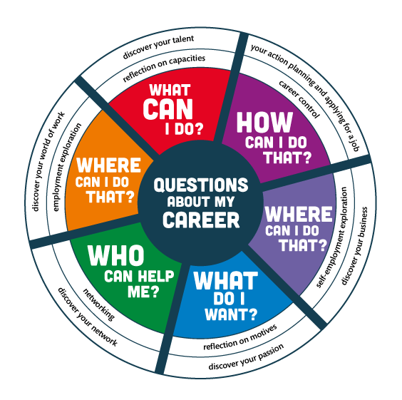
Notes:
The compass can be used to summarise what you are doing ± which questions you have done so far and what will come in the next training days.

Slide 9
Topic 1: Discover your talent
What is meant by ‘Discover your Talent’?
Why is this topic important when you guide youth in their career?
Notes:
Let them explain the topic in their own words, don’t tell it yourself. In case you find the answer not good enough, give feedback on the positive part of it and ask for more details. When you do this seriously, you will see how much they can think about it in their own words. It gives a good starting point for further elaboration.
Discover your Talent means: thinking about your qualities and how you can use these qualities to develop your career. Students/jobseekers and job creators reflect on the qualities they use in everyday life, at school and at (informal) work. They ask others (graduates, teachers, fellow students, employees, entrepreneurs and family members) to give feedback on what they are good at and on what to improve.

Slide 10
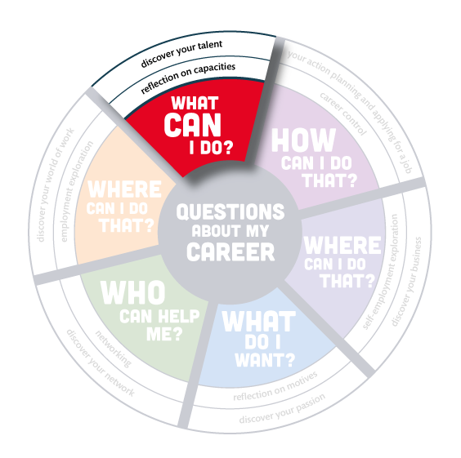
Notes:
Let them explain the topic in their own words, don’t tell it yourself. In case you find the answer not good enough, give feedback on the positive part of it and ask for more details. When you do this seriously, you will see how much they can think about it in their own words. It gives a good starting point for further elaboration.
Discover your Talent means: thinking about your qualities and how you can use these qualities to develop your career. Students/jobseekers and job creators reflect on the qualities they use in everyday life, at school and at (informal) work. They ask others (graduates, teachers, fellow students, employees, entrepreneurs and family members) to give feedback on what they are good at and on what to improve.

Slide 11
Overview EXERCISES ‘Discover your talent’
In total topic 1 ‘Discover your Talent’ consists of 20 exercises;
There are 6 introductory exercises, useful when you start a new group;
Next, there are 14 exercises in which youth can discover their talents (what are they good at?):
  giving and getting compliments;
  giving and getting feedback;
  with a lot of creativity;
  by interviewing each other;
  by presenting their qualities.
Notes:
First look yourself at the exercises in the toolkit. You need to know very well what the topic is about. It is not necessary to know all the exercises by heart, but you need to have an idea of the content and the way of delivering. When participants haven chosen an exercise for the try-out, you can prepare the exercise yourself during a break or prayer time.

Slide 12
Selecting the exercises
In subgroups you read the overview of all the exercises of the topic ‘Discover your Talent’;
Discuss which exercises will be good to select for your own group of youth and explain why?;
Choose 3-5 exercises for your tailor-made programme;
Choose one exercise to deliver in this group;
Prepare that exercise for try-out.
Notes:
It will take a lot of time to read the overview. Therefore pay attention, how they cooperate, how they read aloud, how they discuss or explain the exercises to each other. Walk around to see if you can be of help. Get an idea which exercises will be chosen to practice in this training group. Ask a subgroup to choose a different exercise for try-out, when two groups have selected the same example. (of course it is nice to see as much different exercises as possible)
Make a list of all your participants: you can keep record who has delivered an exercise. It is okay to deliver the exercise with two people, but notice who did the main part and who was more the assistant. Just remember them that everybody has to practice one or two exercises during the T-o-T.

Slide 13
Logbook reflections
Write down in your logbook the 3-5 exercises you have selected for your own group of youth;
Explain why you have chosen them and how they are in line with the needs assessment of your target group;
Write down what you want to learn in the try-out about your guidance competences.
Notes:
Distribute the hand-out with the logbook reflections. It is important to reflect in a proper way. It will help them in designing a tailor-made programme. So take the time for it.
The last question is very difficult, most of the time you will get very general answers. Ask them to become more and more specific, based on what they know about their facilitation skills and the feedback they get and also give in this training.

Slide 14
Try-out of the selected exercises
Give a short introduction about the youth you are guiding and the situation of this group;
Tell what you want to learn from this exercise;
Deliver your exercise according to your preparation;
When you have presented enough we can learn from, the facilitator gives a time-out whether you have finished or not;
Blow off steam: first the ‘demo-trainer’, then feedback from group members: What was good? What needs improvement?;
Write down in your logbook what you learned from the exercise.
Notes:
Invite the ones who are doing the try-out. Prepare with them who the ‘participants/youth’ are. Ask them what they want to learn in this exercise. When everything is clear, give them the floor. It is always difficult to decide when to stop with an exercise. Sometimes it is good to stop very early (when they are completely on the wrong track, then you can give some tips so that they are able to continue), sometimes it is good to let them finish the whole exercise. Take also time for reflection in the whole group. The last stage of the exercise – the reflection – is something a lot of trainers forget. They don’t ask the youth to give a reaction, they give the reflection themselves. In almost every training session, the winding up needs attention: how to reflect and how to use the open questions at that moment?. Two simple questions at the end - What did he/she do well? ; what needs improvement? ’ will elicit excellent feedback from the group members. Take care they give feedback in a respectful way and if not, you can just correct. Both in the positive feedback and in the improvement feedback they will give very good concrete tips. When you have more feedback, just give it. At the end you can also ask why this exercise is good for the youth and if they will put it in their programme (or not).
In practice you can inky do a limited number of try-outs. In the first training group we could only facilitate 3 or 4 exercises on each day. The subgroup who was not able to deliver the exercise got the opportunity to tell about their exercise. And it was promised that next trainings day they could get a turn to facilitate an exercise out of the new topic.

Slide 15
Looking forward and homework
Update your practical assignment with what you have learned today about your planning, the needs assessment of your target group and the try-out of the exercises of the topic ‘Discover your Talent’;
Prepare yourself for topic 2 ‘Discover your Passion’. Read the overview and think about the exercises you like.

Slide 16
Evaluation
Make a gesture that shows how you think and feel about this second day of the training Career Development.
See you in the next meeting!
Asante sana.
All the best!
Notes:
A nice way of evaluating a training day gives fun. It does not take much time and after a full day with a lot of interaction, there is no need to reflect a lot. When a lot of people give a negative gesture, you need to ask about the reasons. Maybe you need to change something in the approach or something happened that upset them. If so, you need to talk about it.

Slide 17
Training of Trainers
Career Development
Day 2 ‘Discover your Talent’
VNA project, My World of Work
Zanzibar

