Slide 1
Training of Trainers
Career Development
Day 3 ‘Discover your Passion’
VNA project, My World of Work
Zanzibar

Slide 2
Karibuni
Programme
Welcome and introduction;
Ears and eyes;
Objectives day 3;
Debriefing homework: ‘plan practical assignment’; ‘needs assessment youth’ and your choice of exercises topic 1;
Overview of the topic ’Discover your Passion’;
Try-out of exercises;
Evaluation, looking forward and homework.

Slide 3
Ears and eyes
Give a reflection on day 2:
The ears: what did you learn about the content of the second day?
The eyes: what did you see about the process in the group during this day?
Notes:
Again ‘ears and eyes’, good to practice once more

Slide 4
Objectives
Debriefing about homework:
  the improvement of the practical assignment;
  the needs assessment of your target group;
  your choice of exercises topic 1;
Selecting the exercises of the topic ‘Discover your Passion’ you want to choose for your group of youth;
Doing try-outs of exercises (as many as possible);
Reflecting and setting goals for the future delivery of your own career development programme.

Slide 5
Debriefing OF homework
As a couple or individual you share with another couple or individual your homework:
  the improvement of the practical assignment
  the needs assessment you have made
  the way you have discussed it with your manager/senior
  the 3-5 (or more) exercises you have selected from the topic ‘Discover your Talent’
Ask questions to clarify, to explain motivations and give each other feedback and tips.

Slide 6
Debriefing homework (cont.)
In the whole group we share the compliments and the improvements of the homework;
Read the format (hand-out 3.4.) for making your practical assignment: how it can be of help to design your tailor-made programme?;
Write down in your logbook what you need to improve more on your planning and your needs assessment.
Notes:
It is also possible to give this format, hand-out 3.4. earlier in the T-o-T - after day 1 or on day 2 - when they start making their tailor-made programme. It is just what you think is better. When you give it after topic 1, they have tried themselves more and then they can be more critical or glad to this format as an aid.

Slide 7
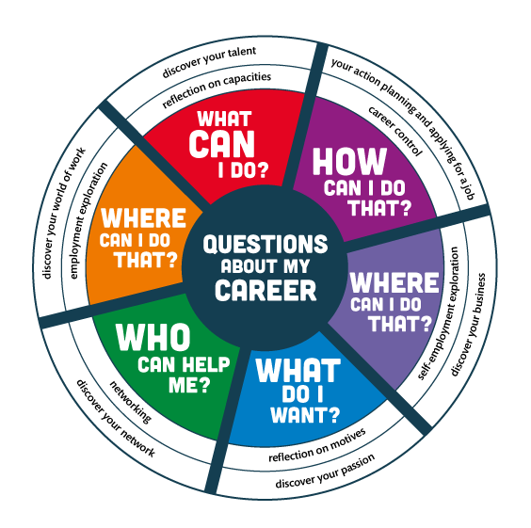
Notes:
The compass can be used to summarise what you are doing ± which questions you have done so far and what will come in the next training days.

Slide 8
Topic 2: ‘Discover your passion’
What is meant by ‘Discover your Passion’?
Why is this topic important when you guide youth in their career?
Notes:
Again, take your time, so that participants can answer these two questions. When they are not reacting immediately, just be silent and wait for a while. They will come and give their contribution. Encourage participants who don´t say much to give it a try. An advice for you…. Try to find a moment to give the explanation in your own words,; you need to practice yourself as well.
means: thinking about your aspirations and values that are important for your career. Students/job seekers and job creators are becoming aware of what they think is important in their life, their education and career. They will discover what gives them a feeling of satisfaction, what they like or dislike and what they (still) need to develop with regard to their ambitions.

Slide 9
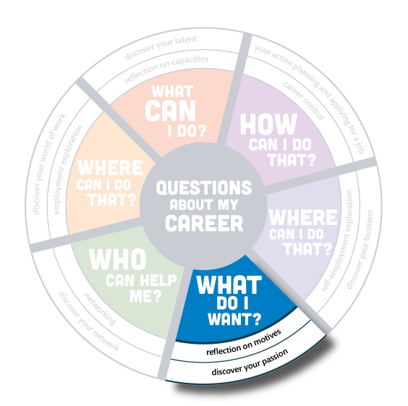
Notes:
Again, take your time, so that participants can answer these two questions. When they are not reacting immediately, just be silent and wait for a while. They will come and give their contribution. Encourage participants who don´t say much to give it a try. An advice for you…. Try to find a moment to give the explanation in your own words,; you need to practice yourself as well.
means: thinking about your aspirations and values that are important for your career. Students/job seekers and job creators are becoming aware of what they think is important in their life, their education and career. They will discover what gives them a feeling of satisfaction, what they like or dislike and what they (still) need to develop with regard to their ambitions.

Slide 10
Overview exercises ‘Discover your Passion’
In totally there are 14 exercises ‘Discover your Passion’:
to get aware of the moments and activities when you feel so good;
to use your creativity to express yourself on desire and passion;
to discover your main career values and your ideal job;
to tell your story and make missions for life, what is important to you?
Notes:
Get familiar with the toolkit: do you recognise the four categories of exercises in the overview of this topic?

Slide 11
Selecting the exercises
In subgroups you read the overview of all the exercises of the topic ‘Discover your Passion’;
Discuss which exercises will be appropriate to select for your own group of youth and explain why?
Choose 3-5 exercises for your tailor-made programme;
Choose one exercise you want to deliver in this group;
Prepare that exercise for try-out.
Notes:
You will see that participants know the structure of the toolkit much better by now. They will know how to use it, working onwards from the overview to the further explanation of the exercises.
Also walk around, give answers when they have questions, give tips when you notice that their preparation is going in the wrong way, sometimes you can just help a little to make adjustments in the subgroup. Be creative and give support just in time and tailor-made. No need for support? Just listen and don’t interrupt.

Slide 12
Logbook reflections
Write down in your logbook the 3 - 5 exercises you have selected for your own group of youth;
Explain why you have chosen them and how they are in line with the needs assessment of your target group;
Write down what you want to learn about your competences by doing a try-out.
Notes:
Distribute the hand-out of this logbook in time. Subgroups that have finished the preparation can give their reflections in an earlier stage than others.

Slide 13
Try-out of the selected exercises
Give a short introduction about the youth you are guiding and about the situation in this group;
Tell what you want to learn from this exercise;
Deliver your exercise as you have prepared it;
When you have presented enough we can learn from, the facilitator gives a time-out whether you are finished or not;
Blow off steam: first the ‘demo-trainer’, then feedback from group members: What was good? What needs improvement?
Write down in your logbook what you have learned from the exercise.

Slide 14
Looking forward and homework
Update your practical assignment with what you have learned today about the needs assessment of your target group and the exercises from the topics ‘Discover your Talent’ and ‘Discover your Passion’. Make use of the format.
In the next training session we work on topic 3 ‘Discover your World of Work’. Read the overview of this topic.

Slide 15
Evaluation
Give your green moments of this day.
Are there any red moments?
Notes:
The first exercise of ‘Discover your Passion’ has been chosen by one of the subgroups. They liked that exercise very much and just started to evaluate about the training in giving a green moment, most of the time they had no red moments during the day. It was always fun to use this and gave good information.

Slide 16
Training of Trainers
Career Development
Day 3 ‘Discover your Passion’
VNA project, My World of Work
Zanzibar

