Slide 1
CBET and Career Development
Introduction Training on CBET
Day 4
VNA project, My World of Work
Zanzibar

Slide 2
Welcome and introduction
Programme
Reflection on day 3;
Objectives of day 4;
Programme Career Development;
Preparing an exercise from one of the topics of Career Development;
Practising of the exercises (as many as possible);
Evaluation, certification and closing words.
Notes:
It is important that all participants have access to the programme: on the website, an USB stick or a hard copy.

Slide 3
Ears and eyes
Give a reflection on day 3
The ears: what did you learn about the content of this third day?
The eyes: what did you see about the process in the group during this day?
Notes:
A nice way of summarising a previous day. You can make very clear the difference between process (the way of learning, the learning climate, the way people are acting, what you can see about their behaviour) and the product (the content, the topics, what is meant by that). Also for your participants it is important to know that difference as they are teachers and trainers themselves. In that case it is important to look to both sides of the training. When people work in a safe and inspiring environment, they will learn the content better. So, when nobody is responding immediately, let them think, encourage them to come with an idea or suggestion and give them time to think.
Time for reflection is a kind of assessment moment for you as a trainer. You can see what group members really remember, how difficult it is to say in own words what you think and how difficult it is to try to be the ears or the eyes of what is happening.

Slide 4
Objectives
To get acquainted with the programme ‘Career Development’ and to practice some exercises;
To reflect on what you have learned during the CBET introduction training;
To make plans what you want to implement and to share tips how to do.

Slide 5
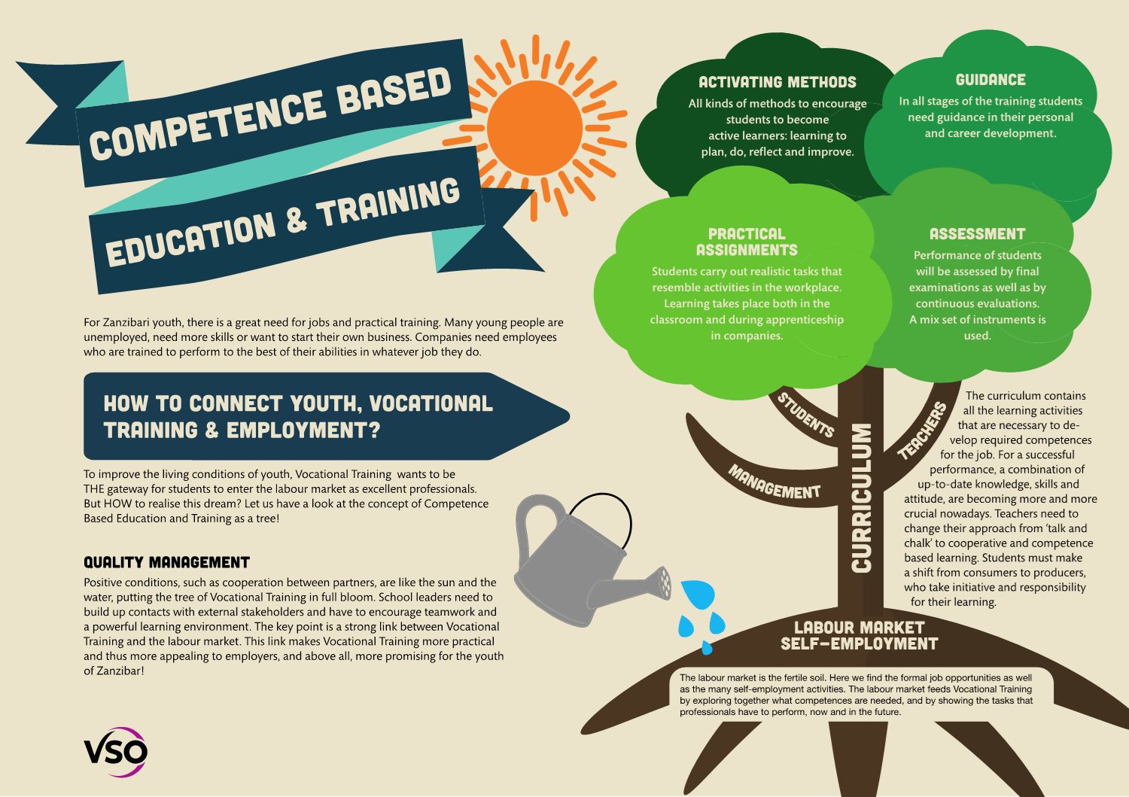
Notes:
In the metaphor of the tree you can see how Career Development is linked to CBET. CD is a part of CBET and deals with Guidance in personal and career development. Giving guidance is a way to connect youth to the labour-market and to self-employment opportunities. So make sure that you always connect youth to real practice (fieldtrips, visits to companies, inviting people from companies in the class, internet search: a lot of opportunities to connect education, youth and the labourmarket!

Slide 6
Programme Career Development
How to guide youth to vocational training and (self-) employment?
The exercises are arranged in 6 career competences;
The toolkit has more than 130 exercises;
The toolkit wants:
  to enable the design of tailor-made programmes;
  to meet the needs of students and jobseekers and is in line with their level;
Add your own exercises….. This programme, toolkit will grow.
Notes:
Ask if somebody can tell what is meant by ‘tailor-made programmes’ and why that is so important.

Slide 7
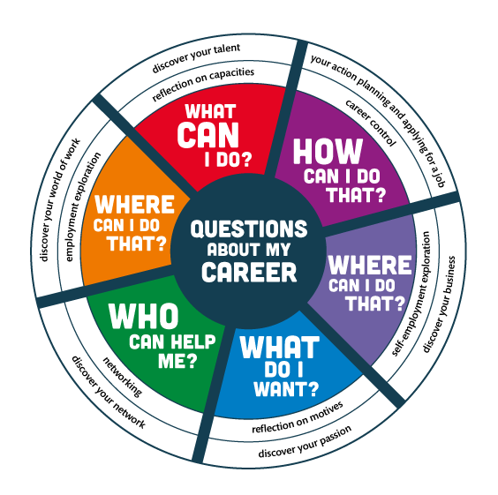
Notes:
Just ask what participants see in this image before you explain each topic in the next slides. Take your time for it. By exploring and thinking, participants get a better understanding of this compass.

Slide 8
Topic 1: Discover your talent
What is meant by ‘Discover your Talent’?
Why is this topic important when you guide youth in their career?
Notes:
means: thinking about your qualities and how you can use these qualities to develop your career. Students/jobseekers and job creators reflect on the qualities they use in everyday life, at school and at (informal) work. They ask others (graduates, teachers, fellow students, employees, entrepreneurs and family members) to give feedback on what they are good at and on what to improve.

Slide 9
Topic 2: Discover your passion
What is this topic all about?
Why is ‘Discover your Passion’ important for the youth?
Notes:
means: thinking about your aspirations and values that are important for your career. Students/job seekers and job creators are becoming aware of what they think is important in their life, their education and career. They will discover what gives them a feeling of satisfaction, what they like or dislike and what they (still) need to develop with regard to their ambitions.

Slide 10
Topic 3: discover your world of work
What do we understand when we talk about ‘Discover your World of Work’?
Why is ‘Discover your World of Work’ important for youth?
Notes:
means: exploring current and future requirements and values in the profession you aspire. Students/jobseekers and job creators develop the skill to find work/a job that corresponds to their personal values. They learn how to find a balance between the prevailing standards/values of the work place and their talents/personal values. Employment exploration is about getting a taste of the reality of the world of work.

Slide 11
Topic 4: discover your network
What is a network?
Why is ‘Discover your Network’ important for the youth?
Notes:
means: identifying your network, building and maintaining it, so that you can develop your career in the best way possible. Students/jobseekers and job creators develop the skill to use their network in such a way that they first can obtain a place in the job market and later on can maintain or change it. They learn how to communicate about what they want and need for their career.

Slide 12
Topic 5: discover your business
What is meant by ‘Discover your Business’?
Why is this topic important in Zanzibar?
Notes:
means: exploring whether you would like to start your own business and develop your career as an entrepreneur/business(wo)man. Students/jobseekers and job creators learn the meaning of how to behave in an entrepreneurial way, how to develop a clear vision about the enterprise they want to start and how to build up skills to make that vision concrete. They learn to set entrepreneurship in motion.

Slide 13
Topic 6: Your action planning and applying for a job
What is meant by ‘Action planning and Applying for a job’?
Why is it important for the youth?
Notes:
means: planning, controlling and adapting your way of learning and working, with the intention to streamline your career development. Students/jobseekers and job creators develop the skill to take initiative and responsibility. They acquire the skill to obtain, keep or change their position in the job market. They learn how to find a job, how to create a CV, and how to conduct an interview.

Slide 14
Structure of Toolkit CAREER DEVELOPMENT
Overview of the exercises per topic
Description of each exercise:
Goal;
Preparation;
Explanation;
Performance;
Tips;
Reflection;
Further examination;
Worksheets.
Notes:
On the first sight this slide does not say anthything to them, but when they are practising, they get used to it.

Slide 15
Selecting the exercises
In subgroups you study one of the overviews with exercises from topic 1, 2, 3, 4, 5 or 6;
Discuss which exercises will be appropriate to select for your own group of students and explain why?
Choose 3 exercises you like best and which are important for your class;
Choose one short exercise you want to deliver in this training group;
Prepare that exercise for a try-out; divide the tasks (who is going to do what?).

Slide 16
Logbook reflections
Write down in your logbook the topic you have studied and which 3 exercises you have selected for your class;
Explain why you have chosen those exercises and how they are in line with the needs of your students;
Write down what you want to learn about your competences by doing a try out.

Slide 17
Practising the selected exercises
Give a short introduction on the students you are guiding and the situation of this class;
Tell what you want to learn from this exercise;
Deliver your exercise as you have prepared it;
When you have presented enough the group can learn from, the trainer gives a time-out whether you are finished or not;
Blow off steam: first the ‘demo-counsellor’, then feedback from group members: What was good? What needs improvement?
Write down in your logbook what you have learned from the exercises.

Slide 18
Evaluation and certification
Please fill in the evaluation form as an aid to learn from this training how to implement CBET;
Go and sit in a circle and share one of your key evaluation points and your next steps;
After that we give our neighbour a compliment about his/her contribution to this training;
Certificates. Hongera to all of us!
A group picture!
Notes:
Take enough time for evaluation. It is nice to sit in a circle and share the experiences and plans. After this, one by one, participants give a compliment to their neighbour. This is a very stimulating closure of the training. In case you make a ceremony of handing over the certificates, you feel sorry that the training has come to an end.

Slide 19
CBET and Career Development
Introduction Training on CBET
Day 4
VNA project, My World of Work
Zanzibar

