Slide 1
Training of Trainers
Career Development
Day 4 ‘Discover your World of Work’
VNA project, My World of Work
Zanzibar

Slide 2
Karibuni
Programme
Welcome and introduction;
The green moments of day 3;
Objectives of day 4;
Debriefing about informing your managers and asking them for feedback on your ‘practical assignment’ and ‘your needs assessment’ of the youth;
Overview of topic ’Discover your World of Work’;
Try-out of exercises;
Evaluation, looking forward and homework.

Slide 3
The green moments of day 3
Giving a reflection on the previous training day….
What were your green moments?
Notes:
Pointing to green moments of the previous session is a nice and easy way to start the next meeting. By just asking for the green moments you create a good atmosphere, a good learning climate. There will be laughter about funny moments or other ways of appreciation. If they also refer to red moments, you just take note of it without giving any reaction. But sometimes a participant wants to tell about a red moment, in that case you need to take that serious. You need to explore what, how and why of that red moment and how to deal with this issue during this training or day.

Slide 4
Objectives
Debriefing about sharing your practical assignment and needs assessment with your manager;
Selecting the exercises from the topic ‘Discover your World of Work’ for your group of youth;
Doing try-outs of exercises (as many as possible);
Reflecting and setting goals for the future delivery of your own career development programme.

Slide 5
Debriefing homework
As a couple or individual you share with another couple or individual your homework:
  the discussion with your manager/senior officer about your training on Career Development;
  what you have learned from that talk;
In the whole group you share conclusions how to involve managers and decisionmakers in the training you develop. What do you need from them?
Notes:
This day the debriefing is scheduled shorter than on the other days. The focus is now more on the involvement of the management. Invite participants who have already talked to their management to report. When everybody has talked to their manager, they can first share in subgroups. If just some participants have done it, do the sharing in the whole group. Management will be invited to come to the last day of training to listen to the presentation of the tailor-made programme of their staff. It is important that they will take their responsibility to support their staff and to create conditions to deliver the tailor-made training Career Development properly to the youth. Think of facilitating time, planning, money, materials and giving continuous support/guidance/development opportunities. Participants need to be pro-active to involve their management not only once, but several times.
With less time for debriefing homework, there will be more time to practise the exercises!

Slide 6
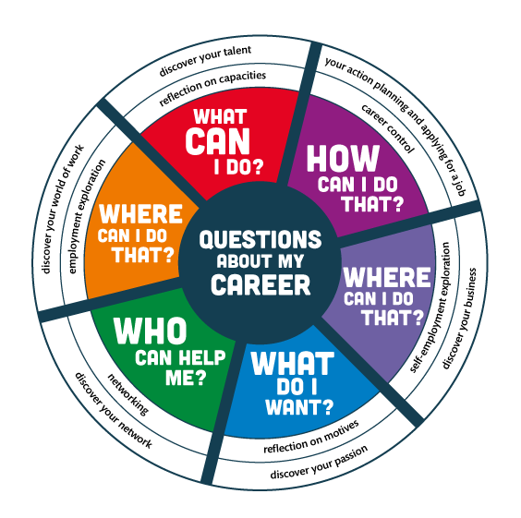
Notes:
The compass can be used to summarise what you are doing ± which questions you have done so far and what will come in the next training days.

Slide 7
Topic 3: ‘Discover your World of Work’
What is meant by ‘Discover your World of Work’?
Why is this topic important when you guide youth in their career?
Notes:
Again, let them give their answers themselves and correct only when it is going in the wrong direction. Let them tell about the good part, but encourage them to give some more specific explanation as well.
means: exploring current and future requirements and values in the profession you aspire. Students/jobseekers and job creators develop the skill to find work/a job that corresponds to their personal values. They learn how to find a balance between the prevailing standards/values of the work place and their talents/personal values. Employment exploration is about getting a taste of the reality of the world of work.

Slide 8
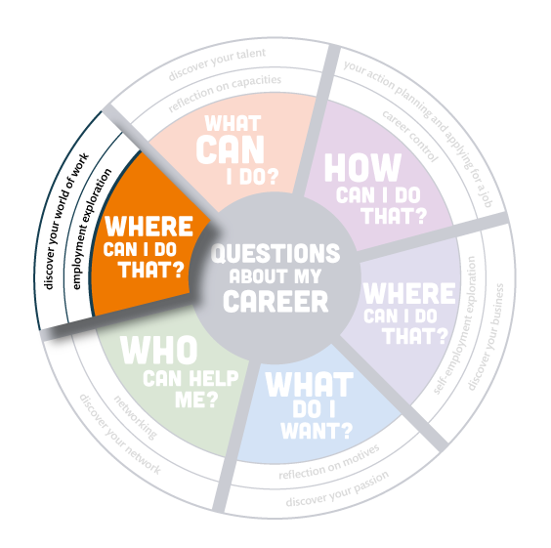
Notes:
Again, let them give their answers themselves and correct only when it is going in the wrong direction. Let them tell about the good part, but encourage them to give some more specific explanation as well.
means: exploring current and future requirements and values in the profession you aspire. Students/jobseekers and job creators develop the skill to find work/a job that corresponds to their personal values. They learn how to find a balance between the prevailing standards/values of the work place and their talents/personal values. Employment exploration is about getting a taste of the reality of the world of work.

Slide 9
Overview EXERCISES ‘Discover your World of Work’
In total the topic ‘Discover your World of Work’ consists 24 exercises. Aims are:
to become aware of the career opportunities and jobs in your own family and circle of people you know;
to explore the jobs in companies by preparing interviews or fieldtrips and reflect on them;
to discover in what kind of company you want to do your industrial training;
to assess whether you have the competences that are required by companies.
Notes:
Prepare yourself to know well the meaning of the various exercises and how to deliver them.

Slide 10
Selecting the exercises
In subgroups you read the overview of all the exercises of the topic ‘Discover your World of Work’;
Discuss which exercises will be appropriate to select for your own group of youth and explain why?
Choose 3-5 exercises for your tailor-made programme;
Choose one exercise you want to deliver in this group;
Prepare that exercise for try-out.
Notes:
You will see that participants know the structure of the toolkit much better by now. They will know how to use it, working onwards from the overview to the further explanation of the exercises.
Also walk around, give answers when they have questions, give tips when you notice that their preparation is going in the wrong way, sometimes you can just help a little to make adjustments in the subgroup. Be creative and give support just in time and tailor-made. No need for support? Just listen and don’t interrupt. Make sure that every subgroup chooses a different exercise for the try-out in the group.

Slide 11
Logbook reflections
Write down in your logbook the 3 - 5 exercises you have selected for your own group of youth;
Explain why you have chosen them and how they are in line with the needs assessment of your target group;
Write down what you want to learn about your guidance competences by doing a try out.

Slide 12
Try-out of the selected exercises
Give a short introduction on the youth you are guiding and the situation in that group;
Tell what you want to learn from this exercise;
Deliver your exercise as you have prepared it;
When you have presented enough to learn from, the facilitator gives a time-out whether you are finished or not;
Blow off steam: first the ‘demo-trainer’, then feedback from group members: What was good? What needs improvement?;
Write down in your logbook what you have learned from the exercise.

Slide 13
Looking forward and homework
Update your practical assignment with what you have learned today and forward it to the trainers who will give feedback;
Next training day we work on topic 4 ‘Discover your Network’. Read the overview of the topic.
Notes:
It is good to see the updates of the practical assignments. Then you can see exactly who is working properly on it and who need more encouragement or sometimes more support.
Give feedback on the documents they have prepared so far: what is good, what questions do you have, what is not clear, not consistent? Give comment when they are not using any words of their own

Slide 14
Evaluation
Put one chair in front of the class. Take care that there is enough space to stand around this evaluation chair;
Everybody can take a turn to take a seat on the chair and give his/her reflection on the day. What do you like and/or what do you dislike?;
The others move closer to the person that gives his/her evaluation when they agree; when they don’t agree, they stay far away.

Slide 15
Training of Trainers
Career Development
Day 4 ‘Discover your World of Work’
VNA project, My World of Work
Zanzibar

