Slide 1
Training of Trainers
Career Development
Day 5 ‘Discover your Network’
VNA project, My World of Work
Zanzibar

Slide 2
Karibuni
Programme
Welcome and introduction;
The green moments of day 4;
Objectives of day 5;
Debriefing about your own tailor-made programme on ‘Career Development’;
Overview of topic ’Discover your Network’;
Try-out of exercises;
Evaluation, looking forward and updating of tailor-made programme.

Slide 3
The green moments of day 4
Giving a reflection on the previous training day……..
What was your green moment?
Notes:
Reflecting and summarising is always important for participants to become aware of their progress and also for those who were not able to attend the training day.

Slide 4
Objectives
Debriefing about your own tailor-made programme ‘career development’, setting clear criteria;
Selecting the exercises from the topic ‘Discover your Network’ for your group of youth;
Doing try-outs of exercises (as many as possible);
Reflecting and setting goals for the future delivery of your own career development programme.

Slide 5
Debriefing of homework
In the whole group we check the homework:
  updating the tailor-made programme;
  sending it for feedback to the trainers;
  involving management. What do you need from them?
Notes:
When you have received many draft copies of practical assignments, you should already have given your feedback on these documents. Now each couple can discuss it during the debriefing session. In the whole group you can give some general feedback and tips about what you have noticed.
When you have discovered a very good draft programme, ask that pair/individual to share it with the whole group. Let them give a presentation. Be flexible during this debriefing. The session can be either be very disappointing, because only some of the group members have submitted their work. Or it can be very exciting because of the quality of the work you have seen. All options will pass by!
Make sure that you clarify the criteria again for the presentation at the end (also, for getting a certificate or not). Encourage the ones who have not done much so far and be strict as well.

Slide 6
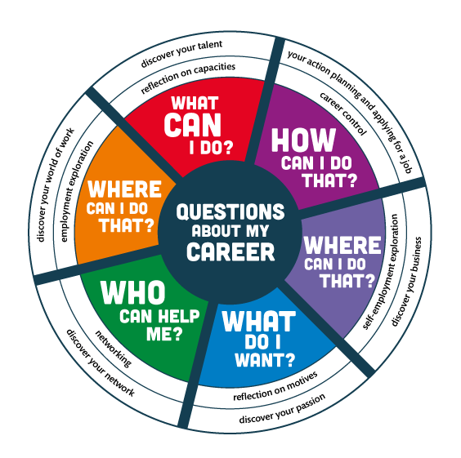
Notes:
The compass can be used to summarise what you are doing ± which questions you have done so far and what will come in the next training days.

Slide 7
Topic 4: discover your network
What is a network?
Why is ‘Discover your Network’ important for the youth?
Notes:
Ask participants to give answers on these questions in their own words. Take your time for this.
means: identifying your network, building and maintaining it, so that you can develop your career in the best way possible. Students/jobseekers and job creators develop the skill to use their network in such a way that they first can obtain a place in the job market and later on can maintain or change it. They learn how to communicate about what they want and need for their career.

Slide 8
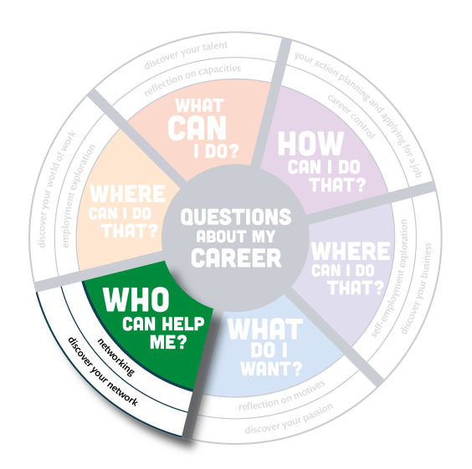
Notes:
Ask participants to give answers on these questions in their own words. Take your time for this.
means: identifying your network, building and maintaining it, so that you can develop your career in the best way possible. Students/jobseekers and job creators develop the skill to use their network in such a way that they first can obtain a place in the job market and later on can maintain or change it. They learn how to communicate about what they want and need for their career.

Slide 9
Overview ‘Discover your network’
In total there are 21 exercises in ‘Discover your Network’.
Aims are:
to become aware what a network is and to identify the persons in your own network;
to explore what the value is of your network, how to give and get support from your network;
to become aware of your communication skills and what the effect of your communication is;
to build, use and maintain your network.
Notes:
Prepare yourself by checking the overview of the exercises in the toolkit.

Slide 10
Selecting the exercises
In subgroups of four you read through the overview of all the exercises of the topic ‘Discover your Network’;
Discuss which exercises will be appropriate to select for your own group of youth and explain why?
Choose 3-5 exercises for your tailor-made programme;
Choose one exercise you want to deliver in this group;
Prepare that exercise for try-out
Notes:
You need to have a list (on a sheet or just for yourself) which participants already have tried-out an exercise, so you can monitor the turns. Make some notes about who does what, because some are too hesitant and don’t take the lead. Others are so enthusiastic that they want to practise all the time and they forget to give weaker persons the opportunity to practice.

Slide 11
Logbook reflections
Write down in your logbook the 3 - 5 exercises you have selected for your own group of youth;
Explain why you have chosen them and how they are in line with the needs assessment of your target group;
Write down what you want to learn about your competences by doing a try-out.

Slide 12
Try-out of the selected exercises
Give a short introduction on the youth you are guiding and the situation in this group;
Tell what you want to learn from this exercise;
Deliver your exercise as you have prepared it;
When you have presented enough to learn from, the facilitator gives a time-out whether you are finished or not;
Blow off steam: first the ‘demo-trainer’, then feedback from group members: What was good? What needs improvement?;
Write down in your logbook what you learned from the exercise.
Notes:
Take time to answer the last question in the logbook. Everybody can learn from each exercise, so let them reflect what they want to remember and what they want to do when they are going to give this exercise to a group. It is also important that participants can monitor their own learning process as a trainer. This reflection needs attention in the presentation at the end of the training.

Slide 13
Looking forward and homework
Update your tailor-made programme ‘Career Development’ with what you have learned today;
Submit your programme to the trainers for personal feedback, if you have not done it yet;
Next training day we will work on topic 5 ‘Discover your Business’. Read the overview.

Slide 14
Evaluation
Give a like or dislike to this day and share the meaning of your reaction.
Asante and good luck with developing your programme.

Slide 15
Training of Trainers
Career Development
Day 5 ‘Discover your Network’
VNA project, My World of Work
Zanzibar

