Slide 1
Training of Trainers
Career Development
Day 6 ‘Discover your Business’
VNA project, My World of Work
Zanzibar

Slide 2
Karibuni
Programme
What did you tell about day 5?;
Objectives of day 6;
Debriefing of your own tailor-made programme ‘Career Development’;
Overview of topic ’Discover your Business’;
Try-out of exercises;
Evaluation, looking forward and updating of tailor-made programme.

Slide 3
What did you tell at home?
When you came home last week, what did you tell your family and friends about the training?
Give a brief summary.
Notes:
A nice exercise. Participants like to tell about the training and in this way they get to know each other better and they get insight in the network group members have at home (topic 4)!

Slide 4
Objectives
Debriefing about ‘your own tailor-made programme on career development’;
Selecting the exercises from the topic ‘Discover your Business’ for your group of youth;
Doing try-outs of exercises (as many as possible);
Reflecting and setting goals for the future delivery of your own career development programme;
Preparing the last presentation of your tailor-made programme.

Slide 5
Debriefing of homework
In the whole group we check your homework:
updating of your tailor-made programme;
sending it for feedback to the trainers;
involving your management. What do you need from them?
Notes:
When many participants have submitted the draft of their practical assignment, you should already have given your feedback on the documents. In that case, each couple can discuss it during the debriefing. In the whole group you can give some general feedback and tips about what you have noticed.
When you have come across a very good assignment, ask that pair/individual to share it with the whole group. They can give a presentation. Be flexible during this debriefing. Sometimes the session can be very disappointing, because only a few participants have submitted their draft programme. It can also be very exciting because of the high quality of the work you have seen. All options are possible!
Make sure that you clarify the criteria again for the presentation at the end (also, for getting a certificate or not)

Slide 6
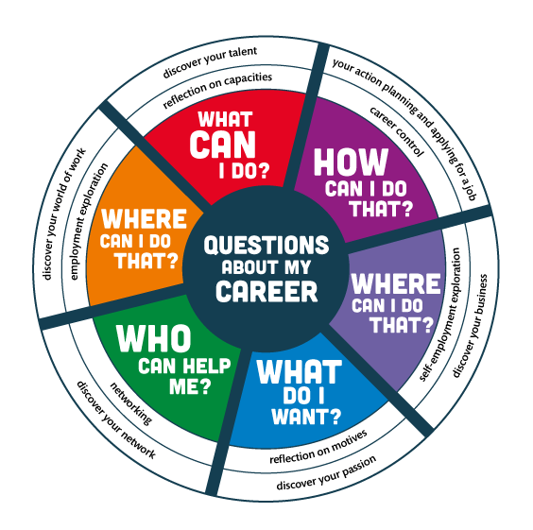
Notes:
The compass can be used to summarise what you are doing ± which questions you have done so far and what will come in the next training days.

Slide 7
Topic 5: ‘Discover your Business’
What is meant by ‘Discover your Business’?
Why is this topic important for the youth of Zanzibar?
Notes:
Ask participants to give their answers in their own words, take your time, let them think.
means: exploring whether you would like to start your own business and develop your career as an entrepreneur/business(wo)man. Students/jobseekers and job creators learn the meaning of how to behave in an entrepreneurial way, how to develop a clear vision about the enterprise they want to start and how to build up skills to make that vision concrete. They learn to set entrepreneurship in motion.

Slide 8
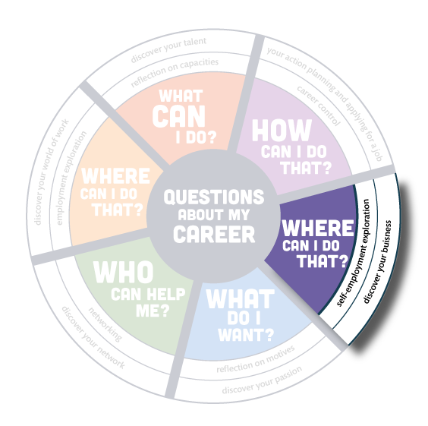
Notes:
Ask participants to give their answers in their own words, take your time, let them think.
means: exploring whether you would like to start your own business and develop your career as an entrepreneur/business(wo)man. Students/jobseekers and job creators learn the meaning of how to behave in an entrepreneurial way, how to develop a clear vision about the enterprise they want to start and how to build up skills to make that vision concrete. They learn to set entrepreneurship in motion.

Slide 9
Overview of exercises ‘Discover your Business’
In total there are 24 exercises in the topic ‘Discover your Business’. Aims are:
to ‘think out of the box’, to use creativity and to apply problem solving skills;
to become aware of what an entrepreneur is, what kind of talents you need for it and to reflect on your own entrepreneurial skills;
to explore the business opportunities in your environment and network;
to learn in negotiation, marketing, accounting, planning and making a business plan.
Notes:
Read thoroughly the exercises in the toolkit as a preparation on this topic

Slide 10
Selecting the exercises
In groups of four you read through the overview of all the exercises of the topic ‘Discover your Business’;
Discuss which exercises will be appropriate to select for your own group of youth and explain why?;
Choose 3 - 5 exercises;
Choose one exercise you want to try-out in this group;
Prepare that exercise for a try-out.

Slide 11
Logbook reflections
Write down in your logbook the 3 - 5 exercises you have selected for your own group of youth;
Explain why you have chosen those exercises and how they are in line with the needs assessment of your target group;
Write down what you want to learn about your competences by doing a try-out.

Slide 12
Try-out of the selected exercises
Give a short introduction on the youth you are guiding and the situation in this group;
Tell what you want to learn from this exercise;
Deliver your exercise as you have prepared it;
When you have presented enough we can learn from, the facilitator gives a time-out whether you are finished or not;
Blow off steam: first the ‘demo-trainer’, then feedback from group members: What was good? What needs improvement?;
Write down in your logbook what you have learned from the exercise.

Slide 13
Looking forward and homework
Update your tailor-made programme on Career Development with what you have learned today;
Submit your programme to the trainers for personal feedback, if you have not done it yet;
Next training day we work on topic 6 ‘Your Action planning and Applying for a job’. Read already the overview.
Notes:
You need to set clear dates when to submit the programmes in order to get personal feedback. When they are too late, they will miss your tips. Make sure to plan the feedback writing on days you don’t have any other activities. It takes some time to produce proper feedback: about one hour for each concept.

Slide 14
Evaluation
Give a recommendation/tip to your management on how to implement this toolkit ‘Career Development’.
Asante and good luck with the development of your programme.

Slide 15
Training of Trainers
Career Development
Day 6 ‘Discover your Business’
VNA project, My World of Work
Zanzibar

