Slide 1
Training of Trainers
Career Development
Day 7 ‘Your Action planning and Applying for a job’
VNA project, My World of Work
Zanzibar

Slide 2
Karibuni
Programme
Welcome and introduction;
Reflection on day 6;
Objectives of day 7;
Debriefing about your own tailor-made programme ‘Career Development’;
Overview of topic ’Your Action planning and Applying for a job’;
Try-out of exercises;
Evaluation; looking forward to our last day of the training: planning of the presentations.

Slide 3
Reflection day 6
What did the colleagues who were not present last week, miss?
Share with them your green and red moments.
Notes:
Due to several reasons, it can happen that people missed day 6. In that case, this kind of summarising is helpful.

Slide 4
Objectives
Debriefing about your own tailor-made programme on Career Development;
Setting clear criteria for the programme and the presentation;
Selecting the exercises from the topic ‘Your Action planning and Applying for a job’ for your group of youth;
Doing try-outs of exercises (as many as possible);
Reflecting and setting goals for the delivery of your own career development programme;
Preparation of the last presentation of your tailor-made programme.

Slide 5
Debriefing of homework
In the whole group we check what need to be done to finalise the practical assignment:
finishing the last bits of the tailor-made programme;
sending it for feedback to the trainers;
reflecting on your personal development during this training;
preparing the presentation (interactive);
Notes:
Don’t take too much time for this debriefing. At the end of the day we are looking forward to the presentations, but it is good to anticipate on what is coming.. and if there are any questions…. Some participants just want to show you their work so far. Ask them to send it to you and if you have some time during the time they work in subgroups, you can have a look at it. When you have a co-facilitator he/she can replace you, otherwise you need to be in the group all the time.

Slide 6

Notes:
The compass can be used to summarise what you are doing ± which questions you have done so far and what will come in the next training days.

Slide 7
Topic 6: ‘Your action planning and applying for a job’
What is meant by ‘Your Action planning and Applying for a job’?
Why is this topic important for guiding youth in their career?
Notes:
Ask participants to tell about this topic in their own words.
means: planning, controlling and adapting your way of learning and working, with the intention to streamline your career development. Students/jobseekers and job creators develop the skill to take initiative and responsibility. They acquire the skill to obtain, keep or change their position in the job market. They learn how to find a job, how to create a CV, and how to conduct an interview.

Slide 8
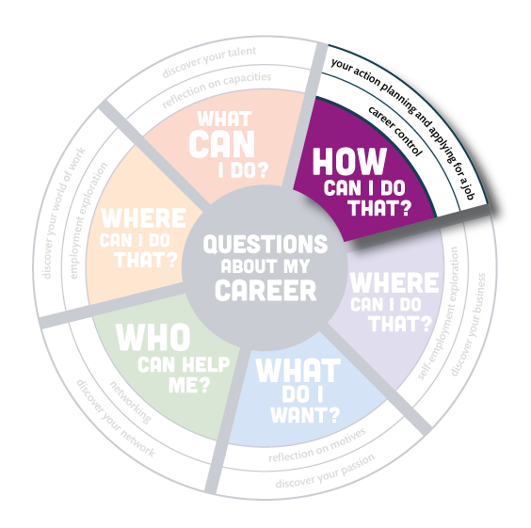
Notes:
Ask participants to tell about this topic in their own words.
means: planning, controlling and adapting your way of learning and working, with the intention to streamline your career development. Students/jobseekers and job creators develop the skill to take initiative and responsibility. They acquire the skill to obtain, keep or change their position in the job market. They learn how to find a job, how to create a CV, and how to conduct an interview.

Slide 9
Overview exercises ‘Your action planning and applying for a job’
In total there are 30 exercises in the topic ‘Your Action planning and Applying for a job’. Aims:
to reflect on which stage of your career you are in and decide about the next steps;
to set S.M.A.R.T. goals on the short and longer term;
to encourage each other to make a new step;
to present yourself, your qualities and your motivation;
to help you in searching for a job, CV- writing and having an interview with an employer.
Notes:
A very big topic, too much to read through them all. The exercises are divided in three parts. Each subgroup gets around ten exercises to peruse and they choose one of them to practice.

Slide 10
Selecting the exercises
In groups of four you read through the overview of 10 exercises in the topic ‘Your Action planning and Applying for a job’. Each group get a different part of the overview;
Discuss which exercises will be appropriate to select for your own group and explain why;
Choose 3 - 5 exercises, for your tailor-made programme you select also from the other parts of the topic;
Notes:
This is a huge topic. It is not possible to study in class the total overview. So, divide the topic in 3 x 10 exercises and give each subgroup a different part of the overview to read. They select their exercises from that part. For their tailor-made programme they can select exercises from 30 exercises.
You need to know which participants have not yet delivered an exercise. Sometimes some only took a helper’s role. They need to be in charge as the main trainer this time. So if you have made up that list of people who have already facilitated, you can point out the ones who need to perform.
There are exercises in this topic that take a long time. Ask the participants not to choose those as the time available for the try-out is limited.
So walk around and see where you can be of help or give tips about what to choose.

Slide 11
Selecting the exercises (cont.)
Choose one exercise you want to deliver in this training group: don’t choose one that takes long;
Prepare that exercise for try-out;
First the people who have not yet demonstrated as the main trainer any exercise, take a turn.
Notes:
This is a huge topic. It is not possible to study in class the total overview. So, divide the topic in 3 x 10 exercises and give each subgroup a different part of the overview to read. They select their exercises from that part. For their tailor-made programme they can select exercises from 30 exercises.
You need to know which participants have not yet delivered an exercise. Sometimes some only took a helper’s role. They need to be in charge as the main trainer this time. So if you have made up that list of people who have already facilitated, you can point out the ones who need to perform.
There are exercises in this topic that take a long time. Ask the participants not to choose those as the time available for the try-out is limited.
So walk around and see where you can be of help or give tips about what to choose.

Slide 12
Logbook reflections
Write down in your logbook the 3 - 5 exercises you have selected for your own group of youth;
Explain why you have chosen them and how they are in line with the needs assessment of your target group;
Write down what you want to learn about your guidance competences by doing a try-out.

Slide 13
Try-out of the selected exercises
Give a short introduction on the youth you are guiding and the situation in this group;
Tell what you want to learn from this exercise;
Deliver your exercise as you have prepared it;
When you have presented enough we can learn from, the facilitator gives a time-out whether you are finished or not;
Blow off steam: first the ‘demo-trainer’; then feedback from group members: What was good? What needs improvement?;
Write down in your logbook what you have learned from the exercise.

Slide 14
Looking forward and homework
Prepare yourself for the presentation on the last training day;
Make sure that your presentation is interactive, nobody can only listen all day;
Think about an energizer at the beginning of your presentation;
Who is going to present their tailor-made programme? We will invite your manager, senior officer or a person you want to be present;
Who needs feedback? Please hand-in your flash now and you will get feedback in time;
Notes:
Final chance to get feedback, just the last opportunity. Some people who were not at present all the time or didn’t do their homework properly, need to say whether they will give a presentation of their tailor-made programme and their own learning results or not. The content of the presentation need to have good quality.
Ask participants whom they want to invite for the presentations and collect the contact details. Ask them to inform their manager/senior officer/colleagues as well.
Promise them to send them the schedule of the presentations by e-mail. Make a list on a sheet which pair will present their programme ate what time. Maybe the participants or their manager or colleagues have some preference when they want to present.

Slide 15
Looking forward and homework (cont.)
Make sure you have all your materials with you: your PowerPoint presentation, flipcharts, hand-outs, everything you need to give a participatory presentation of your ‘tailor-made programme on Career Development’;

Slide 16
Looking forward and homework (cont.)
Criteria for your presentation:
The distributed format need to be used: all the different paragraphs need to be filled in;
Your programme must at least consist of 20 exercises;
Look for content of the presentation at the next slide;
You get 15-25 minutes to present. A tip: do a try-out and discuss your performance with your co-trainer.

Slide 17
Content of the presentations
Context of the training Career Development;
Description and motivation of the target group;
General design of the training;
Content of the training;
Proof of your competences by explaining one exercise in your own words;
Reflection on your own learning process;
Suggestions how to implement the programme in the real situation.
Notes:
This content is in line with the format. Those are the criteria the presentation should meet. And…. energizers are needed.

Slide 18
Tips for the presentations
Prepare your self well: not only the content is important, also the way of presenting;
Use PowerPoint or choose a different way of presenting (flipcharts, singing or drawing);
Make the presentation interactive in order to involve the whole group;
Think of the tips we shared during the training (voice, way of standing, eye contact etc.);
In total we have 15 – 25 minutes for each presentation: we are the timekeepers and we set the alarm;
At the end of each presentation there will be 5 minutes time for feedback by your guests, the group members and trainers.

Slide 19
Evaluation
Finish the following sentence and share it with each other:
For next week I want to present a wonderful programme on Career development for my youth.
To prepare myself well, I need……..
Asante and good luck with the final development of your programme and presentation.

Slide 20
Training of Trainers
Career Development
Day 7 ‘Your Action planning and Applying for a job’
VNA project, My World of Work
Zanzibar

