Slide 1
Training of Trainers
Career Development
Day 8 ‘Presentation programmes Career
Development ´
VNA project, My World of Work
Zanzibar

Slide 2
Karibuni
Programme
Welcome and introduction;
Reflection on day 7;
Objectives of day 8;
Last preparations and checking planning;
Presentations;
Evaluation and next steps;
Certification ceremony.
Notes:
We have made a planning for all presentations. All the participants said that they want to give a presentation, but due what we have seen from them we thought that several (three) presentations would not be given. So we plan them in a way, that there would be more time for others. So we divided them all along the day. And yes, they cancelled their presentations or were coming too late. To avoid this decision at the last day of training, you can also schedule this issue on day 5, when you have finished topic 4. You can ask who want to present their tailor-made programme and that they need to send a draft of the presentation (so far, over the first 4 topics) before day 6 of the training. Based on the quality of this draft, you can give feedback and make a decision on whom can go for the final presentation (and if okay, certification) and whom just attend the last sessions to learn as much as possible (no certificate).
For this last day, there were also some wishes for the time, as some management could only come on a specific time during a limited period. We were able to make the right schedule.

Slide 3
Reflection day 7
What was your green moment on the last training day on the topic ‘Action planning and Applying for a job’?
Notes:
It is nice to show the management that was around, how we have worked during the training.

Slide 4
Objectives
Welcome to all the managers, senior officers and colleagues who are here to learn from the presentation of your practical assignments;
Reflecting on your competences how to develop and deliver tailor-made programmes for your youth;
Evaluation of the training and sharing about the needs for implementation and further development;
Celebrating that we have learned so much!

Slide 5
Last preparation
Collect all the materials you need for your presentation;
Save the PowerPoint presentations on the laptop of the trainer;
Between the presentations there is just two minutes to change;
Notes:
Time for preparation is always needed, also because several people are not very punctual. Make a good planning and take some time for the last preparation, so that you can start the presentations in time at 9.45 hours.

Slide 6
Logbook
In the logbook you write down your observations of each presentation:
  what you like about it;
  what you want to use yourself.
Notes:
Hand-over the logbook and hand-outs to everybody.

Slide 7
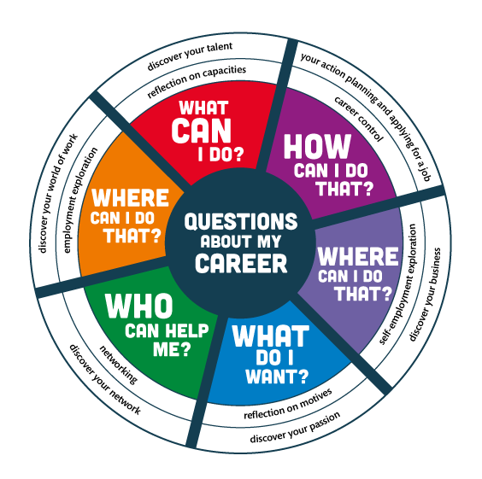
Notes:
Just to explain it a little bit to the visitors. Just welcome them properly and give some explanation about the training and the importance of the presentation and their presence here to listen and to be of support to implement the programme of their staff.

Slide 8
the presentations
In totally we have 15 – 25 minutes for each presentation: the trainers are the timekeeper and set the alarm;
At the end of each presentation there will be 5 minutes for feedback from the guests, group and trainers.
Notes:
After each presentation the trainer can best invite the participants-presenters to stand next to him/her, while he/she asks the group what they liked about the presentations. The trainers should especially invite the management to give a reaction. Do not emphasize too much feedback that is dealing with improvement. The central question of this day is not “what can be done better’, but is more “is it sufficient to certify?”. Some attention can be given to the implementation: how and when are you going to deliver the tailor-made programme?
When a presentation and the tailor-made programme are too poor, the trainer should immediately give the bad news. Sorry, not sufficient, you will not get a certificate and give the reason why. There might be some protest of the participant, but do not argue about it. This will be highly appreciated by the other participants. Also they know, who has done not enough in the whole programme; a fair judgment will be highly appreciated by other participants. It makes also their own presentation and tailor-made programme of more value. When you want to avoid such difficult decisions on the last day, you need to do this assessment earlier in the programme after you have got a draft of the presentation before day 6. See notes slide 2

Slide 9
Evaluation, next steps and certification
Please fill in the evaluation form as an aid to learn from this training how to implement the programme for ‘Guidance on Career development’;
In a circle we share one of our key evaluation points and the next step to take;
After that we thank our neighbour at our right side and give him/her a compliment about his/her contribution to this training;
Certificates. Hongera to all of us!
At the end: group pictures.
Notes:
The criteria for getting a certificate were clear from the beginning. You need to have delivered an exercise, to have attended at least 6 days and to have presented the tailor-made programme. The criteria were at first more strict. You could only have missed just one day, but in that case a lot of people would not have received a certificate. Some reasons why people were not attending were quite clear and acceptable. But not always. It also happened that participants just turned up for a few hours. Therefore the rule has been set that people who didn’t do the presentation didn’t get a certificate. Also participants who failed to do a good presentation (poor content) or who were too often absent, did not get a certificate. Everybody was happy about that rule, they thought it was fair and it gave their own certificate more value.
Thanking each other and giving compliments to one’s neighbour, is a nice approach for a closing ceremony. It is so respectful, people might get tears in the eyes!

Slide 10
Training of Trainers
Career Development
Day 8 ‘Presentation programmes Career
Development ´
VNA project, My World of Work
Zanzibar

